Slide 1

Title of the training/session
Date + Name and email address of the trainer(s)
The project is co-funded by the Justice Program of the European Union (2014 – 2020)
Logo of your organisation
Notes:
Integrate the logo of your organisation on the left side of the CLEAR-Rights logo on each slide.

Slide 2

Module 7
International mechanisms to defend children’s rights
INSERT TIMING and/or Agenda (incl. break)
The project is co-funded by the Justice Program of the European Union (2014 – 2020)
Logo of your organisation

Slide 3




Contents
Part 1: Presentation of UN and European mechanisms
UN mechanisms
UN human rights system
Treaty Bodies
  Their control mechanisms
  Focus on Individual Complaints
European mechanisms
European Court of Human Rights
European Committee of Social Rights
Court of Justice of the European Union
The project is co-funded by the Justice Program of the European Union (2014 – 2020)
Logo of your organisation
Notes:
This presentation will cover both the international level (UN) and the regional level (both EU and Council of Europe). This module is an adaptation in English of the training created and regularly organized by DCI Belgium.

Slide 4






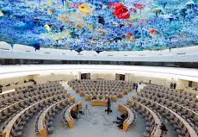

Part 1: Presentation of UN and European mechanisms
UN human rights system
Treaty Bodies
Committee on the Elimination of Racial Discrimination (CERD)
Committee on Economic, Social and Cultural Rights (CESCR)
Human Rights Committee (CCPR)
Committee on the Elimination of Discrimination against Women (CEDAW)
Committee against Torture (CAT)
Committee on the Rights of the Child (CRC)
Committee on Migrant Workers (CMW)
Subcommittee on Prevention of Torture and other Cruel, Inhuman or Degrading Treatment or Punishment (SPT)
Committee on the Rights of Persons with Disabilities (CRPD)
Committee on Enforced Disappearances (CED)
Human Rights Council
Universal Periodic Review (UPR)
Special procedures
Other
Programmes, funds and specialised institutions
…
The project is co-funded by the Justice Program of the European Union (2014 – 2020)
Logo of your organisation
Notes:
The United Nations is an international organization founded in 1945. Currently made up of 193 Member States, the UN and its work are guided by the purposes and principles contained in its founding Charter.
United Nations is involved in many fields. Regarding Human Rights, the system can be described with three branches:
1. Programs, funds and specialised institutions
The UN system counts on Funds and Programmed such as UNDP or UNICEF. But also, the UN specialized agencies are autonomous international organizations working with the United Nations such as ILO and other Other Entities and Bodies such as UNHCR. (more information on all these bodies : https://www.un.org/en/about-us/un-system). They have an important role on the development of international standards to protect children’s rights (hard or soft law, see for example ILO Conventions on child labour or UNICEF Guidelines on Child-friendly Legal Aid) but also on the implementation of international standards (e.g. field work of UNICEF).
2. Treaty Bodies
Nine international human rights treaties have been developed and adopted in the framework of the United Nations, they all create a treaty body : a Committee which monitors the implementation of the treaty (Convention or Covenant) and often, their additional protocols. + the optional protocol on the Convention against torture create a specific treaty body (a subcommittee).
3. The Human Rights Council
The Human Rights Council is an inter-governmental body within the United Nations system responsible for strengthening the promotion and protection of human rights around the globe and for addressing situations of human rights violations and make recommendations on them. It has the ability to discuss all thematic human rights issues and situations that require its attention throughout the year. It meets at the UN Office at Geneva.
The Council is made up of 47 United Nations Member States which are elected by the UN General Assembly. The Human Rights Council replaced the former United Nations Commission on Human Rights. More information on the Council on the leaflet of the HRC https://www.ohchr.org/sites/default/files/Documents/HRBodies/HRCouncil/HRC_booklet_EN.pdf
It has various mechanisms including:
Universal Periodic Review: The Universal Periodic Review is a process in which states review the human rights achievements of all UN member states. It provides an opportunity for each State to present the measures it has taken to improve the human rights situation. For NGOs, it is an opportunity to highlight problems in the implementation of human rights. At the end of the review, states receive recommendations from other states to improve their implementation of human rights.
The Human Rights Council complaint mechanism (more info on: https://www.ohchr.org/sites/default/files/Documents/HRBodies/ComplaintProcedure/ComplaintProcedurebooklet_E.pdf )
The Human Rights Council’s Special Procedures mandate holders are made up of special rapporteurs, independent experts or working groups composed of five members who are appointed by the Council and who serve in their personal capacity. As of October 2021, there are 45 thematic and 13 country mandates. The full list of thematic mandates is available on this database: https://spinternet.ohchr.org/ViewAllCountryMandates.aspx?Type=TM&lang=en ; there are special rapporteurs or working groups on arbitrary detention, on the right to education, on the independence of judges and lawyers, etc.
➔ All these mechanisms and bodies are interesting concerning human rights and children’s rights, they produre a lot of material that can be of interest for you, but we will focus on treaty bodies because they are the one that offer the most relevant mechanism for lawyers for children.

Slide 5
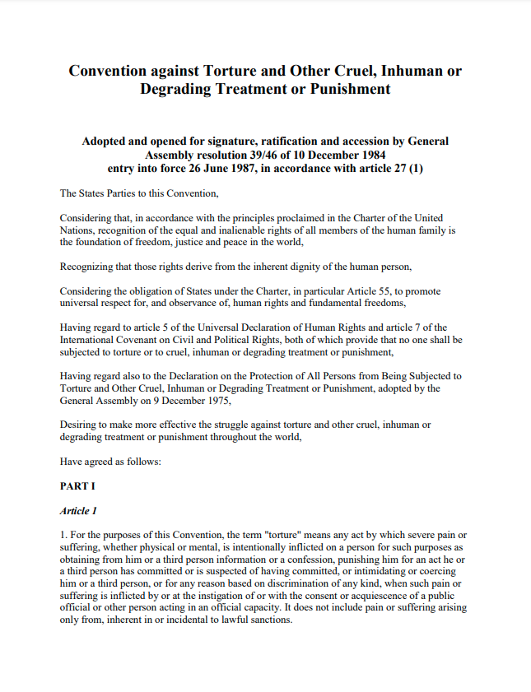
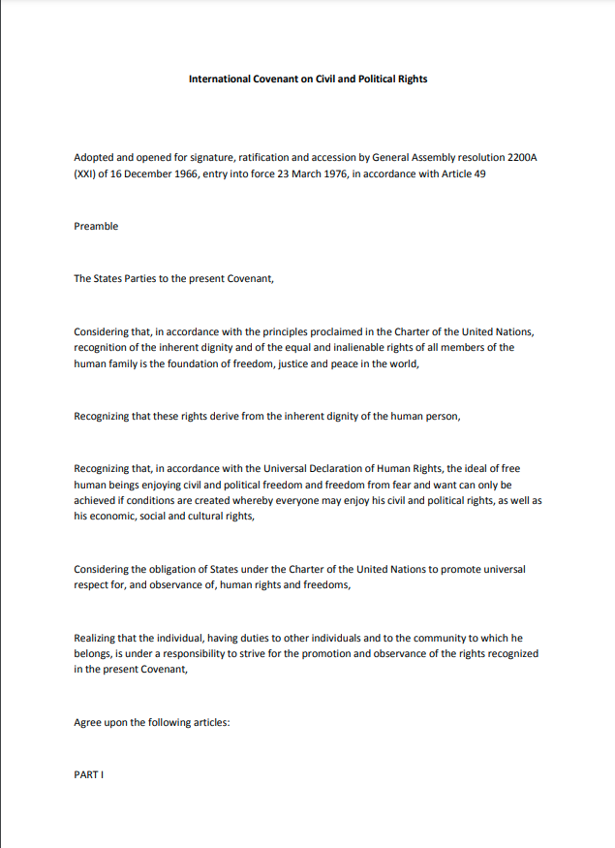
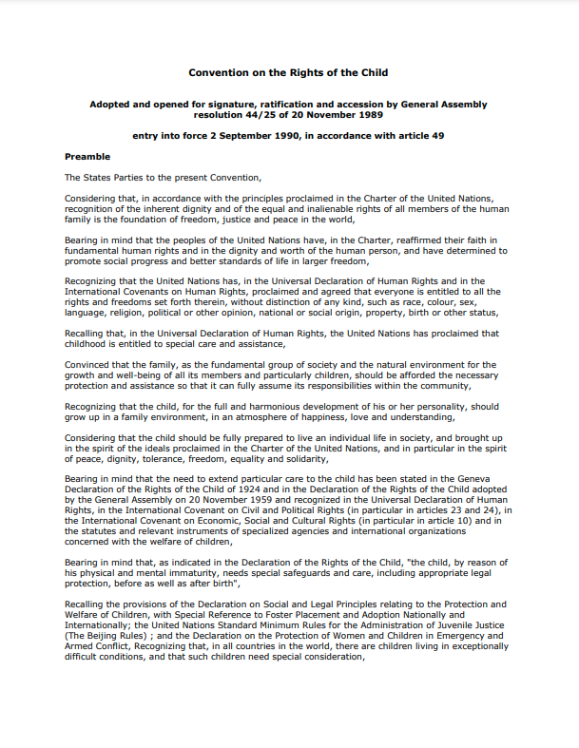
Part 1: Presentation of UN and European mechanisms
UN Treaty Bodies
Committee on the Elimination of Racial Discrimination (CERD)
Committee on Economic, Social and Cultural Rights (CESCR)
Human Rights Committee (CCPR)
Committee on the Elimination of Discrimination against Women (CEDAW)
Committee against Torture (CAT)
Committee on the Rights of the Child (CRC)
Committee on Migrant Workers (CMW)
Committee on the Rights of Persons with Disabilities (CRPD)
Committee on Enforced Disappearances (CED)
Subcommittee on Prevention of Torture and other Cruel, Inhuman or Degrading Treatment or Punishment (SPT)
The project is co-funded by the Justice Program of the European Union (2014 – 2020)
Logo of your organisation
Notes:
The human rights treaty bodies are committees of independent experts that monitor implementation of the core international human rights treaties. Each State party to a treaty has an obligation to take steps to ensure that everyone in the State can enjoy the rights set out in the treaty.
There are ten human rights treaty bodies composed of independent experts of recognized competence in human rights, who are nominated and elected for fixed renewable terms of four years by State parties.
The treaty bodies meet in Geneva, Switzerland. All the treaty bodies receive support from the Human Rights Treaties Division of OHCHR in Geneva.
Committee on Enforced Disappearances (CED) ➔ Monitors implementation of the International Convention for the Protection of All Persons from Enforced Disappearance (23 December 2010).
Committee on the Rights of Persons with Disabilities (CRPD) ➔ Monitors implementation of the International Convention on the Rights of Persons with Disabilities (3 May 2008).
Committee on Migrant Workers (CMW)➔ Monitors implementation of the International Convention on the Protection of the Rights of All Migrant Workers and Members of Their Families (1 July 2003).
Committee on the Rights of the Child (CRC) ➔ Monitors implementation of the Convention on the Rights of the Child (2 September 1990) and its optional protocols.
Committee against Torture (CAT) ➔ Monitors implementation of the Convention against Torture and Other Cruel, Inhuman or Degrading Treatment (26 June 1987).
Committee on the Elimination of Discrimination against Women (CEDAW) ➔ Monitors implementation of the Convention on the Elimination of All Forms of Discrimination against Women (1979) and its optional protocol (3 September 1981).
Human Rights Committee (CCPR) ➔ Monitors implementation of the International Covenant on Civil and Political Rights (23 March 1976) and its optional protocols.
Committee on Economic, Social and Cultural Rights (CESCR) ➔ Monitors implementation of the International Covenant on Economic, Social and Cultural Rights (3 January 1976).
Committee on the Elimination of Racial Discrimination (CERD) ➔ Monitors implementation of the International Convention on the Elimination of All Forms of Racial Discrimination (4 January 1969).
+ Subcommittee on Prevention of Torture and other Cruel, Inhuman or Degrading Treatment or Punishment (SPT) ➔ Established pursuant to the Optional Protocol of the Convention against Torture (OPCAT) (22 June 2006) visits places of detention in order to prevent torture and other cruel, inhuman or degrading treatment or punishment.

Slide 6
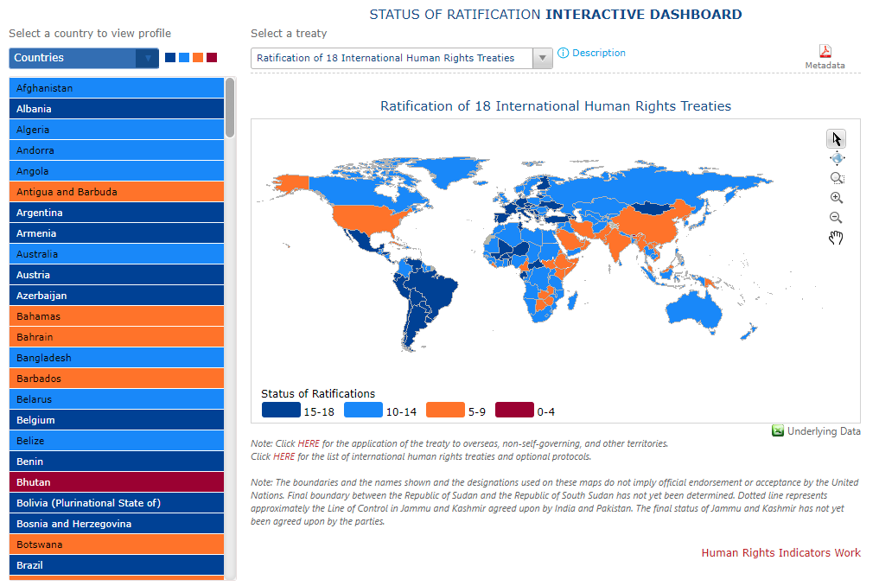
Part 1: Presentation of UN and European mechanisms
UN Treaty Bodies
Which treaty did (NAME OF THE STATE) has ratified?
The project is co-funded by the Justice Program of the European Union (2014 – 2020)
Logo of your organisation
Notes:
One of the preconditions for the Convention to apply in your country (and therefore for the Committee to be able to verify its implementation) is that your State has ratified the Convention. List the conventions ratified by your State among the 9 core human rights treaties (+ OPCAT)
!! As we will explain later on during the presentation, for some mechanisms, in addition to the ratification of the Convention/Covenant, the State needs to have ratified another Optional Protocol (this is the case for example of the OPIC for the procedure of individual complaints to the UN Committee on the Rights of the Child).
State of ratification of the treaties are all available on the ohchr website : https://indicators.ohchr.org/

Slide 7
Part 1: Presentation of UN and European mechanisms
CONTROL MECHANISMS OF TREATY BODIES
A. Reports
B. Inter-State communications
C. Inquiry procedure
D. Visits (SPT) and national prevention mechanisms
E. Early warning measures and urgent procedures (CERD)
F. Individual communications / Individual complaints
The project is co-funded by the Justice Program of the European Union (2014 – 2020)
Logo of your organisation

Slide 8
REPORTS
Part 1: Presentation of UN and European mechanisms
Which committees? All
How does it work?
State party report
Alternative report (NGOs and NHRI)
Pre-session
Concluding observation
Follow up
List of issue prior to reporting
Interactive dialogue
(Sometimes)
How can lawyer for children use this mechanism?
Be in touch with NGOs doing reports and report to them violations you see,
Read the concluding observation the committee has adopted for your country
If you work with foreign children, concluding observation of the committees might help you prouve a situation in the country of origin
The project is co-funded by the Justice Program of the European Union (2014 – 2020)
Logo of your organisation
Notes:
The 9 treaty Committee have a reporting mechanism (Committee on the Elimination of Racial Discrimination (CERD), Committee on Economic, Social and Cultural Rights (CESCR), Human Rights Committee (CCPR), Committee on the Elimination of Discrimination against Women (CEDAW), Committee against Torture (CAT), Committee on the Rights of the Child (CRC), Committee on Migrant Workers (CMW), Committee on the Rights of Persons with Disabilities (CRPD), Committee on Enforced Disappearances (CED)).
Usually, State party write a report to the Committee in which they present all the measures they have undertaken to implement the Convention, but also the gaps they still foresee. Sometimes, shorter procedure have been put in place and instead of being very global, the report of the State is only the response to a list of issues prior to reporting that the Committee wrote and send to the State (usually NGOs and National Human Rights Institution can influence the List of issues by sending informations to the Committee). After the publication of the State party report, NGOs and NHRI (National Human Rights Mechanism) can send Alternative reports to the Committee (they will usually point out violations of human rights they see in the country and mention some recommandations). Then, the committee will have a dialogue with NGOs and NHRI (the pre-session) and then with the State (this one is public). Based on the reports and dialogue, the Committee will publish “Concluding Observation” for the States : a 10 – 20 pages documents reflecting on violations of the Convention in the Country, concerns about possible violations, and recommendations for better implementation of the convention.
As a lawyer for children you might want to use this mechanism in three different ways:
Be in touch with NGOs doing reports and report to them violations you see, (info for the trainer: look into the OHCHR website to find previous alternative report for the UNCRC and communicate the name of NGOs who did a report to the participants);
Read the concluding observation the committee has adopted for your country (info for the trainer: include the link to the most recent concluding observation the UNCRC adressed to your country, highlight if it adressed a recommendation regarding children in conflict with the law) and use them in front of international bodies or internal jurisdiction to advance children’s rights;
If you work with foreign children, concluding observation of the committees might help you prouve a situation in the country of origin.
All information (including reports and alternative reports) regarding the reporting to the UNCRC is available on this website:
https://tbinternet.ohchr.org/_layouts/15/treatybodyexternal/TBSearch.aspx?Lang=en&TreatyID=5&TreatyID=10&TreatyID=11&DocTypeID=5
You can find all information and reports of the other Committees on the website of OHCHR : https://www.ohchr.org/en/treaty-bodies

Slide 9
Part 1: Presentation of UN and European mechanisms
INTER-STATE COMMUNICATION
How does it work? Complaint by a State to the Committee concerned about a treaty violation by another State.
Good offices, conciliation. Advantages: broad scope, wide reach.
Difficulties: double condition of commitment of states, diplomacy
! Both States must have ratified the Convention (or protocol) in question and deposited the declaration of acceptance the number of declarations for the e.v. must be reached!
Examples: CERD, Palestine vs Israel, Qatar vs Saudi Arabia (ongoing)
Which Committees?
Committee on Economic, Social and Cultural Rights
Committee against Torture
Committee on the Elimination of Racial Discrimination
Committee on the Rights of the Child
Committee on Migrant Workers' Rights
Committee on Human Rights
The project is co-funded by the Justice Program of the European Union (2014 – 2020)
Logo of your organisation
Notes:
Explain this procedure in two or three words but do not insist on it too much, as it is not often used and of little use to lawyers directly.

Slide 10
Part 1: Presentation of UN and European mechanisms
OTHER PROCEDURES OF TREATY BODIES
C. Inquiry procedure
D. Visits (SPT) and national prevention mechanisms
E. Early warning measures and urgent procedures (CERD)
The project is co-funded by the Justice Program of the European Union (2014 – 2020)
Logo of your organisation
Notes:
Say a few words about these three procedures, however they are not the more usefull for lawyers then do not take too much time for this.
Info on these procedures you need to know before presenting them in a shorter way:
Inquiry procedure
Which Committees? Committee against TortureCommittee on the Elimination of Discrimination against WomenCommittee on the Rights of Persons with DisabilitiesCommittee on Enforced DisappearancesCommittee on Economic, Social and Cultural RightsCommittee on the Rights of the Child How does it work? These Committees can open an investigation when they have : - reliable information - that a State Party is violating the treaty (if that State has not opted out) - in a serious and/or systematic manner. The enquiry procedure is confidential and throughout the inquiry, the Committee seeks the State's agreement to cooperate, possible visit (State's agreement), State invited to respond to the findings and recommendations of the enquiry.Example: Chilean investigation into children in care, by the CRCTranslated with www.DeepL.com/Translator (free version)
Visits:
Which committee ? The Subcommittee on Prevention of Torture (established by the Optional Protocol to the Convention against Torture and Other Cruel, Inhuman or Degrading Treatment or Punishment)
How does it work? The Subcommittee on Prevention of Torture is responsible for the inspection of places of detention. It may, inter alia: - have access to all places of detention; - have access to all information concerning the number of persons deprived of their liberty in these places of detention - have access to all information concerning the treatment of these persons and their conditions of detention; - interview persons deprived of their liberty, without witnesses, as well as any other person holding relevant informationLink with the "National Preventive Mechanism: mention the name of your National prevention mechanisms, set up according to OPCAT.
Early warning measures and urgent procedures (CERD)
Which Committees? The Committee on the Elimination of Racial Discrimination
How does it work? Preventive mechanism that allows the Committee to react to problems that need immediate attention, before they turn into conflicts. Helps to limit the number of serious violations of the Convention
Among other measures, the Committee may Request the State Party concerned to provide information as a matter of urgency, Request the secretariat to collect information from field presences, Adopt a decision in which it expresses its particular concerns and makes recommendations, Offer to send one or more of its members to the State Party concerned to facilitate the implementation of international standards, offer advisory services and technical assistance from the Office of the High Commissioner
Other information on these procedures are available on the OHCHR website.

Slide 11
Part 1: Presentation of UN and European mechanisms
Individual communications
Which Committees?
Committee on the Elimination of Racial Discrimination (CERD)
Committee on Economic, Social and Cultural Rights (CESCR)
Human Rights Committee (CCPR)
Committee on the Elimination of Discrimination against Women (CEDAW)
Committee against Torture (CAT)
Committee on the Rights of the Child (CRC)
Committee on Migrant Workers (CMW)
Committee on the Rights of Persons with Disabilities (CRPD)
Committee on Enforced Disappearances (CED)
➔ You will need to make a strategic choice
The project is co-funded by the Justice Program of the European Union (2014 – 2020)
Logo of your organisation
Notes:
All these treaty bodies monitor the implementation of their own treaty and receive individual communications.
Some rights are found in more than one of these treaties, so if you find yourself with a young client whose rights are being violated, there may be more than one committee with jurisdiction, so it will be a matter of making a choice because you cannot bring the same case before more than one committee.

Slide 12
Part 1: Presentation of UN and European mechanisms
Individual communications
How does it work?
An individual may lodge a complaint with one of the Committees, if he/she feels that a right protected by the Convention and/or its protocols has been violated.
General idea
“The complaint mechanisms are designed to be accessible to the layperson. It is not necessary to be a lawyer or even to be familiar with legal and technical terms to bring a complaint under these treaties”.
The project is co-funded by the Justice Program of the European Union (2014 – 2020)
Logo of your organisation
Notes:
How does it work?
An individual may lodge a complaint with one of the Committees, if he/she feels that a right protected by the Convention and/or its protocols has been violated.
General idea
“The complaint mechanisms are designed to be accessible to the layperson. It is not necessary to be a lawyer or even to be familiar with legal and technical terms to bring a complaint under these treaties”. (extract of the Factsheet n°7, Individual Complaint Procedures under the United Nations Human Rights Treaties: https://www.ohchr.org/sites/default/files/Documents/Publications/FactSheet7Rev.2.pdf

Slide 13

Part 1: Presentation of UN and European mechanisms
Individual communications Checklist
Main conditions
Violation(s) of the Convention/Covenant
State is party to the Convention/Covenant
Recognition of the Committee’s competence to receive individual complaints (Optional protocol or Declaration)
Who? Anyone, lawyer is not compulsory
Model complaint forms and guidelines (recommendation) in one of the official United Nations languages
Delay: as soon as possible after domestic remedies have been exhausted
Possibility of interim measures
Events after the entry into force in the State party (complaint mechanism)
No other international (regional) body
Exhaustion of domestic remedies
The project is co-funded by the Justice Program of the European Union (2014 – 2020)
Logo of your organisation
Notes:
Conditions (extract of the Factsheet n°7, Individual Complainte Procedures under the United Nations Human Rights Treaties: https://www.ohchr.org/sites/default/files/Documents/Publications/FactSheet7Rev.2.pdf)
While there are some procedural variations among the nine mechanisms, their design and operation are very similar.
A complaint under one of the nine treaties can be brought only against a State that satisfies two conditions. First, it must be a party (through ratification or accession) to the treaty that provides for the rights which have allegedly been violated. Second, the State party must have recognized the competence of the committee monitoring that treaty to receive and consider complaints from individuals. For the International Covenant on Civil and Political Rights, the Convention on the Elimination of All Forms of Discrimination against Women, the Convention on the Rights of Persons with Disabilities, the International Covenant on Economic, Social and Cultural Rights, and the Convention on the Rights of the Child, States recognize the committees’ competence by becoming a party to their optional protocols, i.e., separate treaties adopted to complement the provisions of each of the above-mentioned covenants and conventions.5 For the Convention against Torture, the International Conventionon the Elimination of All Forms of Racial Discrimination, the International Convention on the Protection of the Rights of All Migrant Workers and Members of Their Families, and the International Convention for the Protection of All Persons from Enforced Disappearance, States recognize the committees’ competence by making a declaration to that effect under a specific article of these conventions.6
Who can bring a complaint? Anyone can lodge a complaint with a committee against a State that satisfies these two conditions (being a party to the treaty and having accepted the committee’s competence to examine individual complaints), claiming that his or her rights under the relevant treaty have been violated. It is not necessary to have a lawyer prepare the case, though legal advice may improve the quality of the submissions. Individuals must be aware, however, that the United Nations does not provide legal aid under these procedures. Complaints can be brought on behalf of the alleged victim, with his or her written consent.7 In certain cases, such consent is not required, for example if the alleged victim is in prison without access to the outside world or is a victim of an enforced disappearance. In these cases, the complainant should state clearly why such consent cannot be provided.
What information should be included in a complaint? While a complaint to a committee, also called a communication or a petition, need not be presented in a particular format, the use of the model complaint forms and guidelines annexed below is recommended. The complaint should be in writing, legible, preferably typed, and signed.8 Only communications presented in one of the official United Nations languages (Arabic, Chinese, English, French, Russian and Spanish) can be accepted. The complaint should provide basic personal information—name, nationality, date of birth, postal address and e-mail address of the complainant—and specify the State party against which it is directed. Any subsequent change in address or other contact information should be notified as soon as possible. It is essential to set out, in chronological order, all the facts on which the complaint is based. The account must be as complete as possible and contain all the information relevant to the case. The complainant must state why he or she considers that the facts described constitute a violation of the treaty in question. It is highly recommended that complainants should specify the rights set out in the treaty that have allegedly been violated. It is also advisable to indicate the kinds of remedies that the complainant would like to obtain from the State party, should the committee conclude that the facts before it disclose a violation. The complainant should also detail the steps he or she has already taken to exhaust the remedies available in the State party against which the complaint is directed, that is, steps taken before the State party’s local courts and authorities. The requirement to exhaust domestic remedies means that the claims must have been brought first to the attention of the relevant national authorities, up to the highest available instance. If some of these remedies are pending or have not yet been exhausted, this should also be indicated, as well as the reasons for it. See below for further details. Complainants should supply copies of all documents9 of relevance to their claims and arguments, especially administrative or judicial decisions on the claims issued by national authorities. If these documents are not in an official language of the United Nations, a full or summary translation must be submitted. The documents should be listed chronologically, numbered consecutively and accompanied by a concise description of their contents. The complaint should not exceed 50 pages (excluding annexes). If it exceeds 20 pages, it should also include a short summary of up to 5 pages highlighting its main elements. If the complaint lacks essential information to be processed under these procedures or the description of facts is unclear, the Secretariat of the United Nations (OHCHR) will contact the complainant with a request for additional details or resubmission. Complainants should be diligent in their correspondence with the Secretariat and the information requested should be sent as soon as possible. If the information is not received within a year from the date of the request, the file will be closed. Final decisions adopted by the committees are made public. Therefore, if complainants do not wish their identity to be disclosed in final decisions, they should indicate this at the earliest opportunity. Owing to the level of publicity that the decisions usually receive (including dissemination via the Internet, which makes it virtually impossible to correct and/or delete data), it may not be possible for the United Nations to satisfy requests for anonymity submitted after the publication of final decisions.
When can a complaint be submitted under the human rights treaties? It is important to submit the complaint as soon as possible after domestic remedies have been exhausted. Delays in doing so may make it difficult for the State party to respond properly and for the committee to evaluate the facts thoroughly. In some cases, submission after a protracted period may result in the case being considered inadmissible.
Special circumstances of urgency or sensitivity A committee may, at any stage of the procedure, request the State party to take measures to prevent any irreparable harm to the complainant or alleged victim in connection with the claims in the case. These are called interim measures
Does the complaint relate to events that occurred after the entry into force of the complaint mechanism for the State party concerned? As a rule, a committee does not examine complaints if the facts occurred before this date, as the complaint would be regarded as inadmissible ratione temporis. There are, however, exceptions to this rule, for instance if the effects of the event in question result in a continuous violation of the treaty.
Has the same matter been submitted to another international body? If it has been submitted to another treaty body or to a regional mechanism, such as the Inter-American Commission on Human Rights, the Inter-American Court of Human Rights, the European Court of Human Rights, the African Commission on Human and Peoples’ Rights or the African Court on Human and Peoples’ Rights, the committees cannot examine the complaint. This rule aims to prevent unnecessary duplication at the international level. If the matter has been submitted to another body, the complainant should indicate this in the original complaint, specifying the body to which it was submitted.
Have all domestic remedies been exhausted? As indicated before, a cardinal principle governing the admissibility of a complaint is that the complainant must first have exhausted all relevant remedies that are available in the State party before bringing a claim to a committee. This usually includes pursuing the claim through the local court system, unless there is sufficient evidence that proceedings at the national level have been unreasonably prolonged or would plainly be ineffective. Detailed reasons must be provided as to why the complainant considers that the general rule should not apply. Mere doubts about the effectiveness of a relevant remedy do not, in the committees’ view, dispense with the obligation to exhaust it. Furthermore, if the State party concerned considers that domestic remedies have not been exhausted, it must provide details of the effective remedies available.
Is the complaint precluded by a reservation made by the State to the treaty in question? A State may have entered a substantive reservation to the treaty or a procedural reservation to the complaint mechanism limiting a committee’s competence to examine certain communications.

Slide 14
Part 1: Presentation of UN and European mechanisms
Individual communications Checklist
Focus on the Committee on the rights of the Child – OPIC protocol
Individuals or groups of individuals incl. children;
1 year;
Possible hearing.
See all information in: https://www.ohchr.org/sites/default/files/Documents/Publications/FactSheet7Rev.2.pdf
The project is co-funded by the Justice Program of the European Union (2014 – 2020)
Logo of your organisation
Notes:
Different conditions according to specific committees, focus on CRC, OPIC (extract of the Factsheet n°7, Individual Complainte Procedures under the United Nations Human Rights Treaties: https://www.ohchr.org/sites/default/files/Documents/Publications/FactSheet7Rev.2.pdf)
The Convention on the Rights of the Child, adopted on 20 November 1989, imposes obligations on State parties to respect the rights of the child. The substantive obligations are set out in Part I of the Convention (arts. 1–41), as well as in its Optional Protocol on the sale of children, child prostitution and child pornography and its Optional Protocol on the involvement of children in armed conflict. The Convention’s complaint mechanism is established by its Optional Protocol on a communications procedure, which was adopted on 19 December 2011. It is a separate treaty open to State parties to the Convention and its two substantive Optional Protocols. States that have become a party to the Optional Protocol on a communications procedure recognize the competence of the Committee on the Rights of the Child—a panel of 18 independent experts that meets three times a year—to receive complaints from persons within their jurisdiction alleging violations of their rights under the Convention and its two substantive Optional Protocols.28 In January 2013, the Committee adopted the rules of procedure to be applied to the complaints submitted under the Optional Protocol. Complaints may be submitted by individuals or groups of individuals claiming to be victim(s) of a violation of the Convention and/or its substantive Optional Protocols, regardless of whether their legal capacity is recognized in the State party against which the complaint is directed. Complaints may also be submitted by their designated representatives or by others acting on behalf of the alleged victim(s) with their express consent. According to the Committee’s rules of procedure, if there is a concern that representation, despite the victim’s consent, may be a result of improper pressure or inducement, the Committee may request additional information or documents, including from third-party sources, that show that the submission of a complaint on the alleged victim’s behalf is not a result of improper pressure or inducement and is in the best interests of the child.
Complaints may be submitted on behalf of the alleged victim without such express consent, provided that the complainant can justify his/her action and the Committee deems it to be in the best interests of the child. If possible, the alleged victim, on whose behalf the complaint is presented, may be informed of the complaint and his/her views shall be given due weight in accordance with his/her age and maturity. The Committee may facilitate the friendly settlement of complaints submitted to it. A friendly settlement must be based on respect for the obligations set forth in the Convention and/or its substantive Optional Protocols. The Committee will not accept any friendly settlement that is not based on the respect of such obligations.
The Optional Protocol sets a time limit for initial submissions. A complaint must be submitted within one year of exhausting domestic remedies, unless the complainant can demonstrate that it was impossible to do so.
A complaint is inadmissible if the same matter has already been examined by the Committee or has been or is being examined under another procedure of international investigation or settlement.
The Committee may decide to invite the complainant and/or alleged victim as well as representatives of the State party concerned in order to provide, in person or by way of video or teleconference, further clarification or to answer questions on the merits of the case, provided that the Committee deems it to be in the best interests of the child. Any hearing shall be conducted in a closed meeting. The hearings of alleged victims will not be conducted in the presence of State representatives, unless the alleged victims so request and the Committee deems it in the best interests of the children. The Committee will guarantee child-sensitive procedures at hearings of the alleged victims and ensure that their views are given due weight in accordance with their age and maturity.

Slide 15
Part 1: Presentation of UN and European mechanisms
Summary
 | Reports | Inter-State com | Inquiry | Visits | Early warning | Individual complaint
Elimination of Racial Discrimination (CERD) | X | X |  |  | X | X
Economic, Social and Cultural Rights (CESCR) | X |  |  |  |  | X
Human Rights Committee (CCPR) | X | X |  |  |  | X
Elimination of Discrimination against Women (CEDAW) | X |  | X |  |  | X
Against Torture (CAT) | X | X | X |  |  | X
Subcommittee (SPT) |  |  |  | X
on the Rights of the Child (CRC) | X | X | X |  |  | X
on Migrant Workers (CMW) | X |  |  |  |  | X
on the Rights of Persons with Disabilities (CRPD) | X |  |  |  |  | X
on Enforced Disappearances (CED) | X |  |  |  |  | X
The project is co-funded by the Justice Program of the European Union (2014 – 2020)
Logo of your organisation
Notes:
Highlight the cases of the mechanisms available in your country.
Committee on the Elimination of Racial Discrimination (CERD)
Committee on Economic, Social and Cultural Rights (CESCR)
Human Rights Committee (CCPR)
Committee on the Elimination of Discrimination against Women (CEDAW)
Committee against Torture (CAT)
Committee on the Rights of the Child (CRC)
Committee on Migrant Workers (CMW)
Committee on the Rights of Persons with Disabilities (CRPD)
Committee on Enforced Disappearances (CED)
Subcommittee on Prevention of Torture and other Cruel, Inhuman or Degrading Treatment or Punishment (SPT)
A. Reports
B. Inter-State communications
C. Inquiry procedure
D. Visits (SPT) and national prevention mechanisms
E. Early warning measures and urgent procedures (CERD)
F. Individual communications / Individual complaints

Slide 16
Part 1: Presentation of UN and European mechanisms
Caselaw
All case law of treaty bodies is available on the OHCHR website:
https://tbinternet.ohchr.org/_layouts/15/treatybodyexternal/TBSearch.aspx?Lang=en
Decisions = authoritative interpretations of the respective treaties
But
they are not legally binding on it
The project is co-funded by the Justice Program of the European Union (2014 – 2020)
Logo of your organisation
Notes:
What happens once a committee has decided a case? It should be noted at the outset that there is no appeal against the committees’ decisions and that, as a rule, their decisions are final. What happens to a case subsequently depends on the nature of the decision taken. If a committee decides that the facts before it disclose a violation by the State party of the complainant’s rights under the treaty, it will invite the State party to supply information on the steps it has taken to give effect to its findings and recommendations. If a committee decides that there has been no violation of the treaty or that the complaint is inadmissible, the case is closed.
The committees’ decisions represent an authoritative interpretation of the respective treaties. They contain recommendations to the State party in question but they are not legally binding on it. All committees have developed procedures to monitor whether State parties have implemented their recommendations (so-called follow-up procedures), since they consider that, by accepting the complaint procedures, State parties have also accepted to respect the committees’ findings. If a committee concludes that a violation of a treaty has taken place, the State is invited to provide information, within 180 days, on the steps it has taken to implement the recommendations. The State’s response is then transmitted to the complainant for comment. If the State party fails to take appropriate action, the committee keeps the case under consideration under the follow-up procedure. A dialogue is thus pursued with the State party and the case remains open until satisfactory measures are taken. Information related to follow-up to the committees’ views and recommendations is not confidential and the meetings during which this information is discussed are public.
States have ratified the Convention and the communications mechanism, thereby recognizing both the binding force of the Convention and the power of the Committee to deal with communications from or on behalf of children. Ratification implies that the State agrees to abide by the decisions of the Committees. However, given that they are not legally binding, sometimes problems in the implementation of the decision (it depend on countries). It is still important to advocate for the proper implementation of decisions of the treaty bodies by States.

Slide 17



Part 1: Presentation of UN and European mechanisms
European mechanisms
European Court of Human Rights
European Committee of Social Rights
Court of Justice of the European Union
The project is co-funded by the Justice Program of the European Union (2014 – 2020)
Logo of your organisation
Notes:
Amongst European Mechanisms, the European Court of Human Rights and the European Committee of Social Rights are mechanisms of the Council of Europe. The Council of Europe is an intergovernmental organisation established on 5 May 1949 by the Treaty of London; it is the continent's leading human rights organization. It includes 46 member states, 27 of which are members of the European Union.
The Court of Justice of the European Union is (at its name indicate) a mechanism of the EU (27 member States).
The EU uses the flag of the CoE, which does not make the recognition easier.

Slide 18
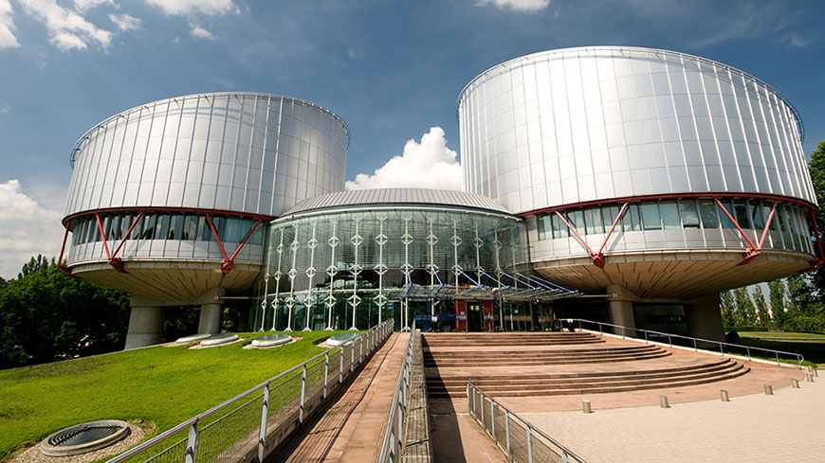

European Court of Human Rights
Part 1: Presentation of UN and European mechanisms
The project is co-funded by the Justice Program of the European Union (2014 – 2020)
Logo of your organisation
Notes:
The European Court of Human Rights is an international court set up in 1959. It rules on individual or State applications alleging violations of the civil and political rights set out in the European Convention on Human Rights. Since 1998 it has sat as a full-time court and individuals can apply to it directly. The Court examined hundreds of thousands applications since it was set up. Its judgments are binding on the countries concerned and have led governments to alter their legislation and administrative practice in a wide range of areas. The Court’s case-law makes the Convention a modern and powerful living instrument for meeting new challenges and consolidating the rule of law and democracy in Europe.
The European Court of Human Rights is based in Strasbourg, France. It consists of a number of judges equal to the number of member States of the Council of Europe that have ratified the Convention for the Protection of Human Rights and Fundamental Freedoms – currently 46 . The Court’s judges sit in their individual capacity and do not represent any State. In dealing with applications, the Court is assisted by a Registry consisting mainly of lawyers from all the member States (who are also known as legal secretaries). They are entirely independent of their country of origin and do not represent either applicants or States.
The Court applies the European Convention on Human Rights. Its task is to ensure that States respect the rights and guarantees set out in the Convention. It does this by examining complaints (known as “applications”) lodged by individuals or, sometimes, by States. Where it concludes that a member State has breached one or more of these rights and guarantees, the Court delivers a judgment finding a violation. Judgments are binding: the countries concerned are under an obligation to comply with them.

Slide 19
European Court of Human Rights
Checklist
Part 1: Presentation of UN and European mechanisms
Main conditions
Violation of the rights under ECHR or Protocols
Violation perpetrated by a State (acts or omissions), no private individual or institution.
Personal conditions:
  No need to be a national (States jurisdiction);
  A private individual or a legal entity such as a company or association;
  Directly and personally been the victim (or legal representative)
  Children can
Prior remedies and deadline:
  Exhaustion of internal remedies (incl. actually raised your complaints )
  4 months
The project is co-funded by the Justice Program of the European Union (2014 – 2020)
Logo of your organisation
Notes:
See all information in European Court of Human Rights, Questions & Answers, available online https://echr.coe.int/Documents/Questions_Answers_ENG.pdf (certainly also in your national language)
A person may lodge an application with the Court if he/she considers that he/she has personally and directly been the victim of a violation of the rights and guarantees set out in the Convention or its Protocols. The alleged violation must have been committed by one of the States bound by the Convention.
Personal conditions:
No need to be a national of one of the States bound by the Convention. The violation must simply have been committed by one of those States against a person within its “jurisdiction”, which usually means on its territory.
A private individual or a legal entity such as a company or association.
Directly and personally been the victim of the alleged violation. The person/legal entity cannot make a general complaint about a law or a measure, for example because it seems unfair; nor can they complain on behalf of other people (unless they are clearly identified and the complainant is their official representative). But, NGO can act on their own behalf or in their capacity as representative of the persons concerned (see case law of the Court CASE OF CENTRE FOR LEGAL RESOURCES ON BEHALF OF VALENTIN CÂMPEANU v. ROMANIA 17 July 2014 and CASE OF ASSOCIATION FOR THE DEFENCE OF HUMAN RIGHTS IN ROMANIA - HELSINKI COMMITTEE ON BEHALF ON IONEL GARCEA v. ROMANIA (24 March 2015).
It does not matter whether the applicant is a minor or an adult (caselaw of the court, 1984)
Conditions of procedure before the application to ECtHR:
The applicant must have used all the remedies in the State concerned that could provide redress for the situation they are complaining about (usually this will mean an application to the appropriate court, followed by an appeal, where applicable, and even a further appeal to a higher court such as the supreme court or constitutional court, if there is one).
It is not enough merely to make use of these remedies. In so doing, the applicant must also have actually raised your complaints (the substance of the Convention violations you are alleging).
The applicant has only four months from the date of the final decision at domestic level (generally speaking, the judgment of the highest court) to lodge an application. After that period the application cannot be accepted by the Court. (In force since 1 August 2021, Protocol 15 to the European Convention on Human Rights reduce the delay from 6 to 4 months).
Against whom?
Against one or more of the States bound by the Convention which, in the applicant’s opinion, has/have (through one or more acts or omissions directly affecting you) violated the European Convention on Human Rights.
The act or omission complained of must be attributed to one or more public authorities in the State(s) concerned (for example, a court or an administrative authority).
The Court cannot deal with complaints against individuals or private institutions, such as commercial companies.
Principle of verticality: an individual can take action against his State before an international court. But the ECtHR has gone even further: when the infringement of the protected right is not directly imputable to the State but is the act of a third party, a private person, the State's responsibility can nevertheless be invoked if the legislation of this State, or the failure of its services, has made it possible for a private person to infringe a right, this is the Horizontal effect of the Convention. This horizontal effect has been created by the case law of the Court.

Slide 20
European Court of Human Rights
Key info
Part 1: Presentation of UN and European mechanisms
All case law of ECtHR available on HUDOC:
https://echr.coe.int/Pages/home.aspx?p=caselaw/HUDOC&c=
Possible Interim measures (compulsory for States)
Decisions of ECtHR are binding.
The project is co-funded by the Justice Program of the European Union (2014 – 2020)
Logo of your organisation
Notes:
See all information in European Court of Human Rights, Questions & Answers, available online https://echr.coe.int/Documents/Questions_Answers_ENG.pdf (certainly also in your national language)
The ECtHR website is very well documented, the following documents might be helpful for lawyers for children:
- The admissibility guide https://echr.coe.int/Pages/home.aspx?p=caselaw/analysis/admi_guide
Factsheets on various topics : https://echr.coe.int/Pages/home.aspx?p=press/factsheets&c=
Guides on articles: https://echr.coe.int/sites/search_eng/pages/search.aspx#{%22fulltext%22:[%22guides%20on%20article%22],%22subcategory%22:[%22publications%22]}
Interim measures: provided for in Article 39 of the Rules of Procedure of the Court. This article provides that the President of the Chamber, either at the request of a party or ex officio, may therefore indicate to the parties an interim measure which he considers appropriate in the interests of the proper conduct of the proceedings. In principle, these interim measures all refer to a state of imminent danger threatening the applicant's life, physical integrity.
Since the Mamatkulov v. Turkey judgment of 6 February 2003, the Court has held that these interim measures are binding on States. States that do not comply with these measures may be condemned for violation of Article 34 of the Convention.
ECHR, ARTICLE 46 Binding force and execution of judgments 1. The High Contracting Parties undertake to abide by the final judgment of the Court in any case to which they are parties. 2. The final judgment of the Court shall be transmitted to the Committee of Ministers, which shall supervise its execution. 3. If the Committee of Ministers considers that the supervision of the execution of a final judgment is hindered by a problem of interpretation of the judgment, it may refer the matter to the Court for a ruling on the question of interpretation. A referral decision shall require a majority vote of two-thirds of the representatives entitled to sit on the committee. 4. If the Committee of Ministers considers that a High Contracting Party refuses to abide by a final judgment in a case to which it is a party, it may, after serving formal notice on that Party and by decision adopted by a majority vote of two-thirds of the representatives entitled to sit on the committee, refer to the Court the question whether that Party has failed to fulfil its obligation under paragraph1. 5. If the Court finds a violation of paragraph 1, it shall refer the case to the Committee of Ministers for consideration of the measures to be taken. If the Court finds no violation of paragraph, it shall refer the case to the Committee of Ministers, which shall close its examination of the case.

Slide 21

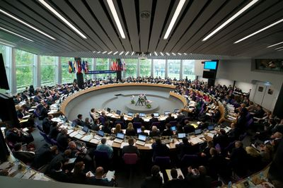
Part 1: Presentation of UN and European mechanisms
European Committee of Social Rights
The project is co-funded by the Justice Program of the European Union (2014 – 2020)
Logo of your organisation
Notes:
Website of the European Committee of Social Rights, “The honouring of commitments entered into under the Charter by the States Parties is subject to the supervision of the European Committee of Social Rights. Its 15 independent, impartial members are elected by the Council of Europe’s Committee of Ministers for a period of six years, renewable once.
The European Committee of Social Rights monitors compliance with the Charter under two complementary mecanisms: through collective complaints lodged by the social partners and other non-governmental organisations (Collective Complaints Procedure), and through national reports drawn up by Contracting Parties (Reporting System).
Insofar as they refer to binding legal provisions and are adopted by a monitoring body established by the Charter and the relevant protocols, Decisions and Conclusions of the European Committee of Social Rights must be respected by the States concerned; even if they are not directly enforceable in the domestic legal systems, they set out the law and can provide the basis for positive developments in social rights through legislation and case-law at national level.”.

Slide 22
Part 1: Presentation of UN and European mechanisms
European Committee of Social Rights – Key info
Collective complaint procedure
Certain NGOs with participatory statuts with the CoE
Follow up of the implementation of the decisions by the the Committee of Ministers of the Council of Europe.
Belgium, Bulgaria, Croatia, Cyprus, the Czech Republic, Finland, France, Greece, Ireland, Italy, the Netherlands, Norway, Portugal, Slovenia and Sweden
The project is co-funded by the Justice Program of the European Union (2014 – 2020)
Logo of your organisation
Notes:
Present shortly this mechanism, as it is not the more usefull for children in conflict with the law, especially if it does not apply yet in your country. It can, however be usefull for children’s rights in general (see its case law on educational violence or unaccompanied foreign minors for example).
Information from the website of the Committee (https://www.coe.int/en/web/european-social-charter/home )
The Collective Complaints procedure was introduced by the Additional Protocol providing for a system of collective complaints, adopted in 1995. The collective complaints procedure has strengthened the role of the social partners and non-governmental organisations by enabling them to directly apply to the European Committee of Social Rights for rulings on possible non-implementation of the Charter in the countries concerned, namely those States which have accepted its provisions and the complaints procedure.
Because of their collective nature, complaints may only raise questions concerning non-compliance of a State’s law or practice with one of the provisions of the Charter. Individual situations may not be submitted. In the light of this, complaints may be lodged without domestic remedies having been exhausted and without the claimant organisation necessarily being a victim of the relevant violation.
Who? certain international non-governmental organisations (INGOs) holding participatory status with the Council of Europe; social partners at national level. Furthermore, any State may grant representative national non-governmental organisations (NGOs) within its jurisdiction the right to lodge complaints against it. So far only Finland has done so.
If a complaint is considered admissible by the European Committee of Social Rights, it adopts a decision on the merit of complaint. This decision establishes whether a State’s law and/or practice is or is not in compliance with one or more provisions of the Charter. The decision is forwarded by the Committee to the parties and, in view of its follow-up, to the Committee of Ministers of the Council of Europe.
Insofar as they refer to binding legal provisions and are adopted by a monitoring body established by the Charter and the Protocol providing for the system of complaints, the decisions of the European Committee of Social Rights must be respected by the States concerned; however, they are not enforceable in the domestic legal system. In practice, this means that when the European Committee of Social Rights rules that the situation in a country is not in compliance with the Charter, the complainant organisation cannot require the Committee’s decision to be enforced in domestic law as would be the case with a ruling by a court in the State concerned.
be lodged against a State in which the Charter is in force and which has accepted the system of collective complaints; as of 1 March 2013, the States having accepted the Additional Protocol providing for a system of collective complaints were as follows: Belgium, Bulgaria, Croatia, Cyprus, the Czech Republic, Finland, France, Greece, Ireland, Italy, the Netherlands, Norway, Portugal, Slovenia and Sweden;
The complaint must concern one or more provisions of the Charter, possibly in combi-nation, accepted by the State concerned; in principle, the Charter provisions in respect of which complaints may be lodged are:
a. Articles 1-19 of Part II of the 1961 European Social Charter, Articles 1-4 of Part II of the 1988 Additional Protocol to the 1961 European Social Charter;
b. Articles 1 to 31 of Part II and Article E of Part V of the Revised European Social Charter.
The European Social Charter is based on what is termed a ratification system, enabling States, under certain circumstances, to choose the provisions they are willing to accept as binding international legal obligations.
Under this system, each Party undertakes:
to consider Part I of the Charter as a declaration of the aims which it will pursue by all appropriate means, as stated in the introductory paragraph of that part;
to consider itself bound by at least six of the following nine articles of Part II of this Charter: Articles 1, 5, 6, 7, 12, 13, 16, 19 and 20 (in the corresponding provision of the 1961 Charter the Articles referred to were Articles 1, 5, 6, 12, 13, 16 and 19);
to consider itself bound by an additional number of articles or numbered paragraphs of Part II of the Charter which it may select, provided that the total number of articles or numbered paragraphs by which it is bound is not less than sixteen articles or sixty-three numbered paragraphs (in the corresponding provision of the 1961 Charter, the total number of articles or numbered paragraphs was supposed not to be less than 10 articles or 45 numbered paragraphs).
Table of provisions accepted by parties: https://rm.coe.int/country-by-country-table-of-accepted-provisions/1680630742

Slide 23
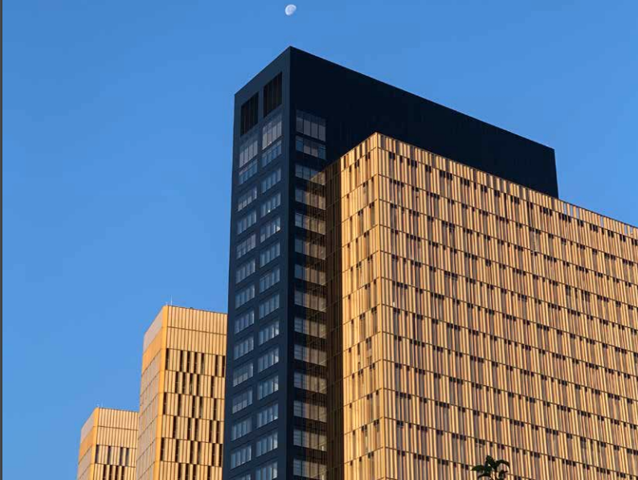
Part 1: Presentation of UN and European mechanisms
Court of Justice of the European Union
The project is co-funded by the Justice Program of the European Union (2014 – 2020)
Logo of your organisation
Notes:
Since the establishment of the Court of Justice of the European Union in 1952, its mission has been to ensure that "the law is observed" "in the interpretation and application" of the Treaties.
As part of that mission, the Court of Justice of the European Union:
reviews the legality of the acts of the institutions of the European Union,
ensures that the Member States comply with obligations under the Treaties (incl. EU charter of fundamental rights), and
interprets European Union law at the request of the national courts and tribunals.

Slide 24
Part 1: Presentation of UN and European mechanisms
What about our national mechanisms?
The project is co-funded by the Justice Program of the European Union (2014 – 2020)
Logo of your organisation
Notes:
Before starting part 2, to provide a full picture to the participants, the trainers can add the national mechanisms as well (e.g. complaint mechanisms within law enforcement, within institutional care, ombudsman etc.).

Slide 25

Part 2: Analysing advantages and disadvantages of these mechanisms
Part 2: Analysing advantages and disadvantages of these mechanisms
Steps of the exercise:
Group reflexion - 10’
Plenary session – 10’
The project is co-funded by the Justice Program of the European Union (2014 – 2020)
Logo of your organisation
Notes:
All these mechanisms are slightly different, they have advantages and disadvantages that lawyers should have in mind when they will choose which mechanism is the most suitable in one given situation.
Ask the participants to form groups of 3 – 4 people and to analyse advantages and disadvantages of the mechanisms based on their knowledge and the previous presentation. (10 minutes)
Plenary session: ask each group to present for one mechanism what they have listed as advantages and disadvantages. Ask the other groups to complete and complete yourself with the additional information on the PowerPoint.
This exercise will also be an opportunity for the participants to handle the information learned during the previous presentation, to remember it and to question it.
Print the following blank tables and give them to each groups. See the additional information slide 26.

Slide 26

Exercise: Analysing advantages and disadvantages
Complaint to the European Court of Human Rights
Advantages | Disadvantages
Individual communication to UN treaty Bodies
Advantages | Disadvantages
Notes:
Translate and print the tables.

Slide 27

Exercise: Analysing advantages and disadvantages
Collective complaint to the European Committee of Social Rights
Advantages | Disadvantages
Reporting to UN treaty Bodies
Advantages | Disadvantages
Notes:
Translate and print the tables.

Slide 28
Part 2: Analysing advantages and disadvantages of these mechanisms
Results of the exercise
Complaint to the European Court of Human Rights
Advantages | Disadvantages
The decision is legally binding for the State. The decision may have a greater impact than just for that child, by setting a precedent. If needed, there is a possibility of Interim measures (and they compulsory for States). Unlike a collective complaint, there is no need to prove that the problem concerns many people. There is no age requirement to act. | Cost (lawyer: possibilities of legal aid) Risks of reprisals (also risk of media exposure, invasion of privacy) Exhaustion of internal remedies Length of proceedings (including exhaustion of domestic remedies) A choice must be made because the same issue should not be submitted to two different international bodies Short delay (only 4 months)
The project is co-funded by the Justice Program of the European Union (2014 – 2020)
Logo of your organisation
Notes:
Translate and print the tables.

Slide 29
Part 2: Analysing advantages and disadvantages of these mechanisms
Results of the exercise
Individual complaints to UN treaty Bodies
Advantages | Disadvantages
Possibility of interim measures (but many States consider they are not compulsory). The formalism is quite limited, these procedures are supposed to be “accessible to laypeople”. There are 9 treaty bodies, you can choose the most suitable for your case (if applicable in your country) and/or the one with a good pre-established case law in the matter of the case. You can ask for the anonymity of the case. | For CRC (OPIC), longer delay than ECtHR: 1 year. Delay: exhaustion of internal remedies + time of consideration of the complaint by the committee can be very long (especially for a child who has his/her own perception of the time). Even if the States have to implement the decisions, they are not stricto sensu binding. Then, some States are quite reluctant in the implementation of the decisions. Need to prove the exhaustion of national remedies (however you can prove that you did not use them because they were not effective).
The project is co-funded by the Justice Program of the European Union (2014 – 2020)
Logo of your organisation
Notes:
Specific rules might vary from one Committee to another, invite all participants to consult the specific rules of proceedings before introducing an individual complaint. However, the above mentioned advantages and disadvantages are common to UN treaty bodies.

Slide 30
Part 2: Analysing advantages and disadvantages of these mechanisms
Results of the exercise
Collective complaint to the European Committee of Social Rights
Advantages | Disadvantages
No need to exhaust internal remedies. Influence of the group as opposed to the individual: it brings additional weigh. Obligation of the State to respond to complaints received. Allows violations to be identified that could not be brought before national courts. No need to have the mandate/represent the person(s) in question. | Must go through an accredited NGO Strength of decisions: less effect than an individual decision Not all states have signed up to this mechanism Heavy and long procedure Diplomacy v. rights - implementation of decisions?
The project is co-funded by the Justice Program of the European Union (2014 – 2020)
Logo of your organisation

Slide 31
Part 2: Analysing advantages and disadvantages of these mechanisms
Results of the exercise
Reporting to UN treaty Bodies
Advantages | Disadvantages
Very broad analysis of all rights on the territory Involvement of different actors (States, civil society) Space for dialogue (sometimes) No need for a specific case to address shortcomings on certain rights Opportunity to receive advice from international experts Concluding observation can be an interesting argument in front of a national jurisdiction | Not binding - depends on state commitment - difficulties in implementing concluding observations. Reporting cycles far apart (sometimes almost 10 years) It does not provide a response to an individual situation: recommendations are general
The project is co-funded by the Justice Program of the European Union (2014 – 2020)
Logo of your organisation

Slide 32
Part 3: Case study: which mechanism should I use to defend the rights of my young client?
Steps of the exercise:
Group work on the case study – 20’
Plenary session – 15’
The project is co-funded by the Justice Program of the European Union (2014 – 2020)
Logo of your organisation
Notes:
In the vast majority of cases, lawyers will have to choose the best mechanism given that the same case cannot be introduced to more than one international body (some exceptions exists but the length of the proceedings really imply that the lawyer make the best choice from the beginning).
Write two short case study presenting the situation of two minors in conflict with the law that are adapted to your national context and ask participants to choose the most suitable international mechanism for these two cases. Participants should do this case study in small groups of 3 – 4 people. Then, the Plenary session of the case study should involve all participants: all groups will share their work and the trainer should also share information.
Integrate in the case law, the following information:
In one of the situation, internal remedies are not exhaustive, however participants can argue that the remaining internal remedies would not be efficient (and therefore do not need to be exhausted);
In one of the situation, at least, the child is deprived of liberty;
In one of the situation, at least, the emergency of the situation requires interim/urgent measures (participants will have to question this);
In one of the situation, the last decision of the national jurisdiction was 5 months ago;
➔ if one of the participant to the training has a case s/he wants to bring to the attention of his/her group, let them replace one of the case study by this real one.
During the Plenary session, also open the question of the proper information of the child and his/her right to participate to the choice to follow with international mechanism.

Slide 33
Case study: which mechanism should I use to defend the rights of my young client?
Case 1: description of the situation ……………………………………………………………………………………………………………………………………………………………………………………………………………………………………………………………………………………………………………………………………………………………………… | Case 2: description of the situation ………………………………………………………………………………………………………………………………………………………………………………………………………………………………………………………………………………………………………………………………………………………………………
Analyse the situation in group, which international mechanism is the more adapted to the situation? | Analyse the situation in group, which international mechanism is the more adapted to the situation?
…………………………………………………………………………………………………………………………………………………………………………………………………………………………………………………………………………………………………………………………………………………………………………………………………………………………………………………………………………………………………………………………………………………………………………………………………………………………………………………………………………………………………………………………………………………………………………………………………………………………………………………………………………………………….……………………………………………………………………. | ……………………………………………………………………………………………………………………………………………………………………………………………………………………………………………………………………………………………………………………………………………………………………………………………………………………………………………………………………………………………………………………………………………………………………………………………………………………………………………………………………………………………………………………………………………………………………………………………………………………………………………………………………………………………..……………………………………………………………………
Notes:
Translate, complete and print the tables.

Slide 34
Part 4: Ethical considerations
Brainstorming: what ethical considerations should a lawyer take into account when assessing the opportunity of using an international mechanism for the case of his/her child client?
The project is co-funded by the Justice Program of the European Union (2014 – 2020)
Logo of your organisation
Notes:
In all actions that the lawyer undertakes when representing a child in conflict with the law, he or she must act ethically, with respect for the rights of the child and keeping in mind his/her role to promote the best interests of the child as a primary consideration. This consideration of ethics is also essential when considering whether to use an international mechanism. Start the activity with a brainstorm: ask participants what ethical considerations a lawyer should take into account when assessing whether to use international remedies.

Slide 35

Part 4: Ethical considerations
Do not harm:
Precautionary principle
Analysis of the potential risks with the child
Protective environment and interviews.
Information
Participation – informed and free consent
Right to privacy
The project is co-funded by the Justice Program of the European Union (2014 – 2020)
Logo of your organisation
Notes:
Here are some recommendations regarding ethics, present to the participants the one they did not mention during the brainstorming:
Do not harm
Precautionary principle: prevent children and young people from being exposed to any risks. It is necessary to identify the potential risks to which children and young people may be exposed and which may lead to violations of children's rights (for example, the risk of invasion of privacy, abuse, violence, etc.).
Sometimes, the risks can only be identified by the child himself or herself. For this reason, the mark of informed consent must make it possible to eliminate the last sources of potential harm.
Ensure that the international proceeding do not harm children Sharing their experiences may be upsetting or traumatic for children. This is why interviews with children should be done in a sensitive and child-friendly manner.
Information
Children and young people should be informed: on their rights, on how their participation will take place and its scope, about the procedure (length, necessary involvement of the child etc.) and its possible outcomes and consequences;
The child should be regularly informed about the evolution of his/her case.
Ensure a real and meaningful participation
The lawyer should properly inform the child so that s/he gives his/her informed and free consent to the international complaint.
Right to privacy
The use of the international mechanism should not result in public exposure of the child, ensure that the child's personal information and photograph cannot be published in the press and take all necessary measures available in these international remedies to ensure respect for the child's private life.

Slide 36
Thank you for your participation !
The project is co-funded by the Justice Program of the European Union (2014 – 2020)
Logo of your organisation

