Slide 1
Title of the training/session
Date + Name and email address of the trainer(s)
The project is co-funded by the Justice Program of the European Union (2014 – 2020)
Logo of your organisation
Notes:
Integrate the logo of your organisation on the left side of the CLEAR-Rights logo on each slide.

Slide 2

Module 1
Specifics of criminal proceedings for children in conflict with the law – Knowing it and explaining it to children
INSERT TIMING and/or Agenda (incl. break)
The project is co-funded by the Justice Program of the European Union (2014 – 2020)
Logo of your organisation
Notes:
Insert the timing of the module on this slide and present to the participants the different steps of the module.

Slide 3



Part 1
Specific approach of the system of justice for children suspected, accused or convicted for an offence
20 - 30 minutes
The project is co-funded by the Justice Program of the European Union (2014 – 2020)
Logo of your organisation
Notes:
You can delete the clock and indication of time here if you want, it is more an information for you than for the participants.
Replace the map of Belgium by the map of your country (Romania, France, Hungary or the Netherlands are available on slide 14)
The first part of this module is a short (about 20 - 30 minutes) presentation of the philosophy /Approach, main component and standards of the system of justice for children suspected, accused or convicted for an offence.
First, you will present some information given by international standards, then some key elements of the European standards (EU and Council of Europe), and then you will give information (very shortly) regarding the philosophy of the system in your country (the main law on child justice, the code of youth justice or even the preparatory documents of these laws can provide a good explaination of the philosophy and goals of the system of justice for children suspected or accused in your country).
This information is an important prerequisite for presenting the actual procedure to the lawyers, as it will enable them not only to know what the procedure is, but also to know what it should aim at, what the general objective should be.

Slide 4
Part 1: Specific approach of the system
The main idea:
“Children differ from adults in their physical and psychological development. Such differences constitute the basis for the recognition of lesser culpability, and for a separate system with a differentiated, individualized approach. Exposure to the criminal justice system has been demonstrated to cause harm to children, limiting their chances of becoming responsible adults.”
Committee on the Rights of the Child, General Comment 24
The project is co-funded by the Justice Program of the European Union (2014 – 2020)
Logo of your organisation
Notes:
UN Committee on the rights of the Child, General Comment n°24 on children’s rights in the child justice system CRC/G/GC/24, §2 and 3, “Children differ from adults in their physical and psychological development. Such differences constitute the basis for the recognition of lesser culpability, and for a separate system with a differentiated, individualized approach. Exposure to the criminal justice system has been demonstrated to cause harm to children, limiting their chances of becoming responsible adults. 3. The Committee acknowledges that preservation of public safety is a legitimate aim of the justice system, including the child justice system. However, States parties should serve this aim subject to their obligations to respect and implement the principles of child justice as enshrined in the Convention on the Rights of the Child. As the Convention clearly states in article 40, every child alleged as, accused of or recognized as having infringed criminal law should always be treated in a manner consistent with the promotion of the child’s sense of dignity and worth. Evidence shows that the prevalence of crime committed by children tends to decrease after the adoption of systems in line with these principles. “

Slide 5
Part 1: Specific approach of the system
Key concept
A child in conflict with the law : a person who has reached the age of criminal responsibility but not the age of majority (under 18 years old), who is suspected or accused of having committed an offence under his national criminal law.
The project is co-funded by the Justice Program of the European Union (2014 – 2020)
Logo of your organisation
Notes:
A child : A child is every person below the age of eighteen (18) years unless under the law applicable to the child, majority is obtained earlier. (UNCRC, art. 1; Directive (EU) 2016/800, art. 3.1). The UNCRC defines a ‘child’ as a person below the age of 18, unless the laws of a particular country set the legal age for adulthood younger (UNCRC, art. 1). “For the purposes of this Directive the following defini - tions apply: ‘child’ means a person below the age of 18” (directive (EU) 2016/800, art. 3.1).
A child in conflict with the law: A child in conflict with the law is a person who has reached the age of criminal responsibility but not the age of majority (under 18 years old), who is suspected or accused of having committed an offence under his national criminal law. (CRC/C/ GC/10, Introduction, §1) The age that needs to be taken into consideration to determine whether a child is in conflict with the law is the age at the time of committing the offence, not later than that. A child in conflict with the law, alleged to have committed a criminal offence, is involved in youth justice proceedings. In many countries these proceedings, which result in sanctions and measures, are not classified as “criminal” under the nation - al law but are criminal in nature, according to the autonomous understanding of the term “criminal” as adopted by international and regional bodies. CRC/C/GC/24, Terminology “children alleged as, accused of or recognized as having infringed criminal law”

Slide 6
Part 1: Specific approach of the system
UN Convention on the Rights of the child, art. 40
“3. States Parties shall seek to promote the establishment of laws, procedures, authorities and institutions specifically applicable to children alleged as, accused of, or recognized as having infringed the penal law, and, in particular:
(a) The establishment of a minimum age below which children shall be presumed not to have the capacity to infringe the penal law;
(b) Whenever appropriate and desirable, measures for dealing with such children without resorting to judicial proceedings, providing that human rights and legal safeguards are fully respected.
4. A variety of dispositions, such as care, guidance and supervision orders; counselling; probation; foster care; education and vocational training programmes and other alternatives to institutional care shall be available to ensure that children are dealt with in a manner appropriate to their well-being and proportionate both to their circumstances and the offence.”
The project is co-funded by the Justice Program of the European Union (2014 – 2020)
Logo of your organisation
Notes:
Explain art 40 of the UNCRC
CRC art 40 “Article 40
1. States Parties recognize the right of every child alleged as, accused of, or recognized as having infringed the penal law to be treated in a manner consistent with the promotion of the child's sense of dignity and worth, which reinforces the child's respect for the human rights and fundamental freedoms of others and which takes into account the child's age and the desirability of promoting the child's reintegration and the child's assuming a constructive role in society.
(…)
3. States Parties shall seek to promote the establishment of laws, procedures, authorities and institutions specifically applicable to children alleged as, accused of, or recognized as having infringed the penal law, and, in particular:
(a) The establishment of a minimum age below which children shall be presumed not to have the capacity to infringe the penal law;
(b) Whenever appropriate and desirable, measures for dealing with such children without resorting to judicial proceedings, providing that human rights and legal safeguards are fully respected.
4. A variety of dispositions, such as care, guidance and supervision orders; counselling; probation; foster care; education and vocational training programmes and other alternatives to institutional care shall be available to ensure that children are dealt with in a manner appropriate to their well-being and proportionate both to their circumstances and the offence.”

Slide 7
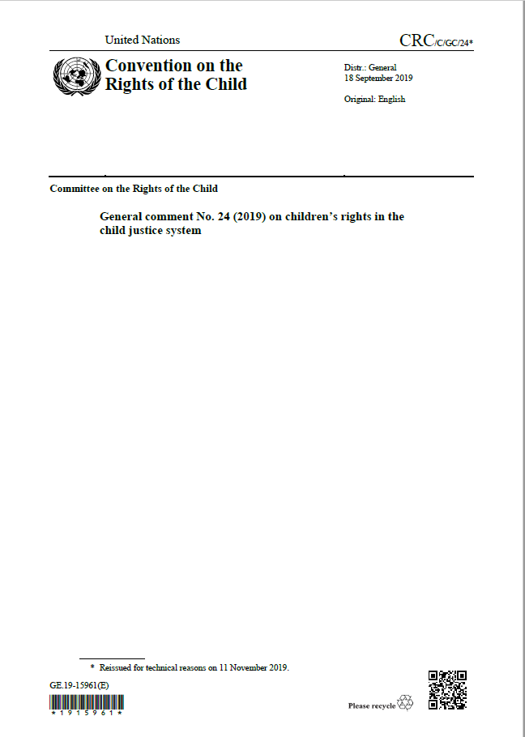

Part 1: Specific approach of the system
UN fundamental principles on child justice
General comment n°24 of the Committee on the rights of the child
Prevention and early intervention
Measures for children above MACR (diversion or disposition)
Age and child justice systems (Minimum age of criminal responsibility)
Guarantees for a fair trial
Deprivation of liberty, including pretrial detention and post-trial incarceration
The project is co-funded by the Justice Program of the European Union (2014 – 2020)
QR Code to the General comment
Logo of your organisation
Notes:
The present general comment replaces general comment No. 10 (2007) on children’s rights in juvenile justice. Present some of its main inputs to the participants. Recall to the participants what is a General Comment of the UNCRC.
The scope of the general comment : “Child justice system” = the legislation, norms and standards, procedures, mechanisms and provisions specifically applicable to, and institutions and bodies set up to deal with, children considered as offenders. (see part III. Terminology, §8). It is interesting to see that there was a swift in the terminology, given that “juvenile” is pejorative in English, the committee now recommends to use “child justice” instead of “juvenile justice”.
Prevention of child offending, including early intervention directed at children below the minimum age of criminal responsibility (§9 to 12) – States who ratified the UNCRC must develop and implement prevention strategies. They should include support to families (prevention is very much linked to the obligation of the State to provide the appropriate support to parents who have the mission of education, CRC art, 18 and 27) and address roots causes of children’s involvement in the child justice system. Regarding children who are below the minimum age of criminal responsibility (MACR): if they have a behavior that would, if they were above the MACR, be considered and offence, they should benefit from a child-friendly and multidisciplinary responses and it must be preceded by a comprehensive and interdisciplinary assessment of the child’s needs. In addition, prevention means that some minor offences should be decriminalized (especially status offences).
Measures for children above MACR (diversion or disposition) (§13 to 19) – “Under article 40 (3) (b) of the Convention, States parties are required to promote the establishment of measures for dealing with children without resorting to judicial proceedings, whenever appropriate. In practice, the measures generally fall into two categories: (a) Measures referring children away from the judicial system, any time prior to or during the relevant proceedings (diversion); (b) Measures in the context of judicial proceedings.”. “Diversion should be the preferred manner of dealing with children in the majority of cases.”, it should be used for a wide range of offences (even serious ones when appropriate) and opportunities for diversion should be open at various stages of the proceeding. These measures should respect human rights of the child and legal safeguard, therefore the Committee lists several conditions (free and voluntary consent, legal assistance etc.). Regarding measures taken in the context of judicial proceedings, “The child justice system should provide ample opportunities to apply social and educational measures, and to strictly limit the use of deprivation of liberty, from the moment of arrest, throughout the proceedings and in sentencing. States parties should have in place a probation service or similar agency with well-trained staff to ensure the maximum and effective use of measures such as guidance and supervision orders, probation, community monitoring or day reporting centres, and the possibility of early release from detention.”. Other inputs in part E of the general comments on the measures: “The laws should contain a wide variety of non-custodial measures and should expressly prioritize the use of such measures to ensure that deprivation of liberty is used only as a measure of last resort and for the shortest appropriate period of time.”, no corporal punishment (§75), main idea “the reaction to an offence should always be proportionate not only to the circumstances and the gravity of the offence, but also to the personal circumstances (age, lesser culpability, circumstances and needs, including, if appropriate, the mental health needs of the child), as well as to the various and particularly long-term needs of the society. A strictly punitive approach is not in accordance with the principles of child justice spelled out in article 40 (1) of the Convention.”.
Age and child justice systems (Minimum age of criminal responsibility) : see next slide
Guarantees for a fair trial (§38 to 71) – importance of the training of professionals to effectively guarantee fair trials, safeguards against discrimination are needed. Other usual condition for fair trials are listed by the committee such as: No retroactive application of child justice, Presumption of innocence, Right to be heard (with specifics for children, reference to GC n°12 of the Committee), Effective participation in the proceedings, Prompt and direct information of the charge(s), Legal or other appropriate assistance (The Committee recommends that States provide effective legal representation, free of charge, for all children who are facing criminal charges before judicial, administrative or other public authorities Child justice systems should not permit children to waive legal representation unless the decision to waive is made voluntarily and under impartial judicial supervision. (§51)), Decisions without delay, Presence of the parents or guardians, etc.
Deprivation of liberty – “The leading principles for the use of deprivation of liberty are: (a) the arrest, detention or imprisonment of a child is to be used only in conformity with the law, only as a measure of last resort and for the shortest appropriate period of time; and (b) no child is to be deprived of his or her liberty unlawfully or arbitrarily”

Slide 8
Part 1: Specific approach of the system
Age and child justice systems
Minimum age of criminal responsibility
Age at the time of the offence
Above the legal age of criminal liability
Penal system of adults
Legal age for criminal liability
18 years of age
Minimum 14 but encourage 15 or 16
Minimum Age of Criminal Responsibility (MACR)
Above the MACR
Child justice procedures
Children with developmental delays or neurodevelopmental disorders or disabilities
Child friendly and multidisciplinary responses
Below the MACR
The project is co-funded by the Justice Program of the European Union (2014 – 2020)
Logo of your organisation
Notes:
Explain briefly the scheme to the participants. Sources: CRC/G/GC/24 - §20 to 37
Global idea: General Comment 24, §8 “Minimum age of criminal responsibility: the minimum age below which the law determines that children do not have the capacity to infringe the criminal law. “ / « Children who are below the minimum age of criminal responsibility at the time of the commission of an offence cannot be held responsible in criminal law proceedings. Children at or above the minimum age at the time of the commission of an offence but younger than 18 years can be formally charged and subjected to child justice procedures, in full compliance with the Convention. The Committee reminds States parties that the relevant age is the age at the time of the commission of the offence.” (§20)
Age of the MACR: minimum 14, recommended 15 or 16: “States parties are encouraged to take note of recent scientific findings, and to increase their minimum age accordingly, to at least 14 years of age. Moreover, the developmental and neuroscience evidence indicates that adolescent brains continue to mature even beyond the teenage years, affecting certain kinds of decision-making. Therefore, the Committee commends States parties that have a higher minimum age, for instance 15 or 16 years of age, and urges States parties not to reduce the minimum age of criminal responsibility under any circumstances, in accordance with article 41 of the Convention.
23. The Committee recognizes that although the setting of a minimum age of criminal responsibility at a reasonably high level is important, an effective approach also depends on how each State deals with children above and below that age.”
Children with developmental delays or neurodevelopmental disorders or disabilities: “ (for example, autism spectrum disorders, fetal alcohol spectrum disorders or acquired brain injuries) should not be in the child justice system at all, even if they have reached the minimum age of criminal responsibility. If not automatically excluded, such children should be individually assessed”
Age at the time of the offence: “29. The child justice system should apply to all children above the minimum age of criminal responsibility but below the age of 18 years at the time of the commission of the offence.”, event if they turn 18 during trial or sentencing process.
Other key info: under 18, they should not be treated as adults and laws that allow it should be changed (§30),
Above18 ? “32. The Committee commends States parties that allow the application of the child justice system to persons aged 18 and older whether as a general rule or by way of exception. This approach is in keeping with the developmental and neuroscience evidence that shows that brain development continues into the early twenties.”

Slide 9

Part 1: Specific approach of the system
UN fundamental principles on child justice
Other key sources regarding child justice:
Other General comments of the UNCRC (12, 14, etc.)
The “Beijing Rules” (UN Standards Minimum Rules for the Administration of Justice)
The “Riyadh Guidelines” (UN Guidelines for the Prevention of Juvenile Delinquency)
The “Havana Rules” (UN Rules for the Protection of Juveniles Deprived of their Liberty)
The project is co-funded by the Justice Program of the European Union (2014 – 2020)
Logo of your organisation
Notes:
In order for a child justice system to be in line with the rights of the child, it should not only be in line with the UNCRC (and general comments n°24), but also with other fundamental international standards such as:
- Other General comment of the UNCRC such as General comment n°12 on the right to be heard (contains some § specifics to justice) and 14 on the best interests of the child;
the UN Standard Minimum Rules for the Administration of Juvenile Justice (“The Beijing Rules”) which, even if not legally binding (soft law), represent minimum conditions which have been accepted at international level for the treatment of children who are in conflict with the law.
Example: Beijing Rules, Rule 5 “Aims of juvenile justice”: “The juvenile justice system shall emphasize the well-being of the juvenile and shall ensure that any reaction to juvenile offenders shall always be in proportion to the circumstances of both the offenders and the offence”.
The UN Guidelines for the Prevention of Juvenile Delinquency (“The Riyadh Guidelines”) provide a practical, positive and pro-active approach to preventing the rise of crime in the youth population by listing various (non-binding) methods to dis courage juvenile delinquency,
Example: The Riyadh Guidelines, “Fundamental principles”: “The prevention of juvenile delinquency is an essential part of crime prevention in society. By engaging in lawful, socially useful activities and adopting a humanistic orientation towards society and outlook on life, young persons can develop non-criminogenic attitudes”.
United Nations Rules for the Protection of Juveniles Deprived of their Liberty (“The Havana Rules”). These rules are intended to establish minimum standards for the protection of children deprived of their liberty in all forms, consistent with their human rights and fundamental freedoms, with a view to counteracting the detrimental effects of all types of deprivation of liberty and to fostering the child’s reintegration into society.
Example: The Havana Rules, “Fundamental perspectives”: “The juvenile justice system should uphold the rights and safety and promote the physical and mental well-being of juveniles. Imprisonment should be used as a last resort”.

Slide 10
Part 1: Specific approach of the system
Main characteristics of an effective and appropriate child justice system
Treatment consistent with the child’s sens of dignity and worth, that takes into account the child’s age and specific needs
Prevention
Fundamental principles of a highly developed child justice system
Treatment that reinforces the child’s respect for the human rights and freedoms of others
Accessibility
Training of professionals (multidisciplinary)
Treatment that promotes the child’s right to education, vocational training, employment, rehabilitation and reintegration in the society
Guarantees the right to participate in and to understand the proceedings
Special protection regarding deprivation of liberty
Guarantees for a fair trial
Diversion
The project is co-funded by the Justice Program of the European Union (2014 – 2020)
Logo of your organisation
Notes:
Present briefly the graphic to the participants. It is a summary of fundamental principles stated in the UNCRC (art,40 and 37), CRC/C/GC/24 and other international standards mentioned before.
Source: Defence for children international (DCI) – Belgium, Practical Guide for Lawyers – How to defend a child in conflict with the law?, page 36. (My Lawyer, My Rights project, https://lachild.eu/wp-content/uploads/2016/05/PRACTICAL-GUIDE-FOR-LAWYERS.pdf )

Slide 11
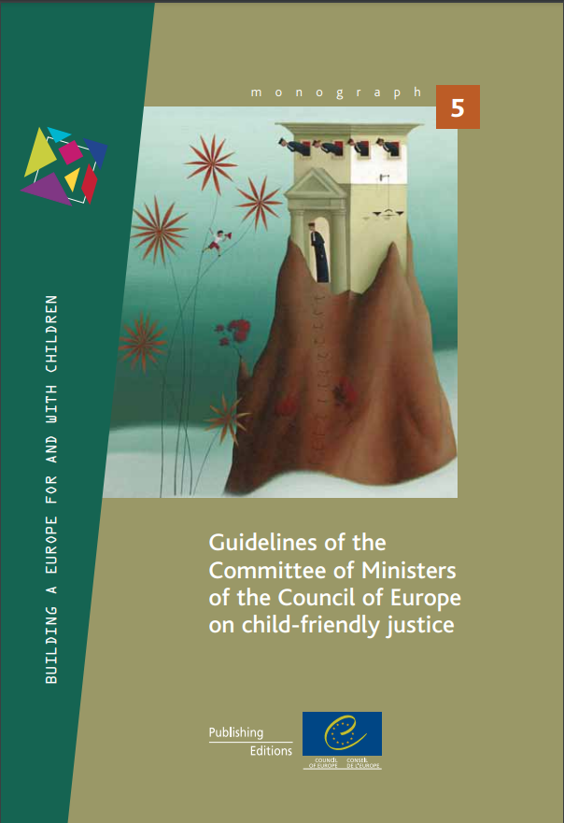
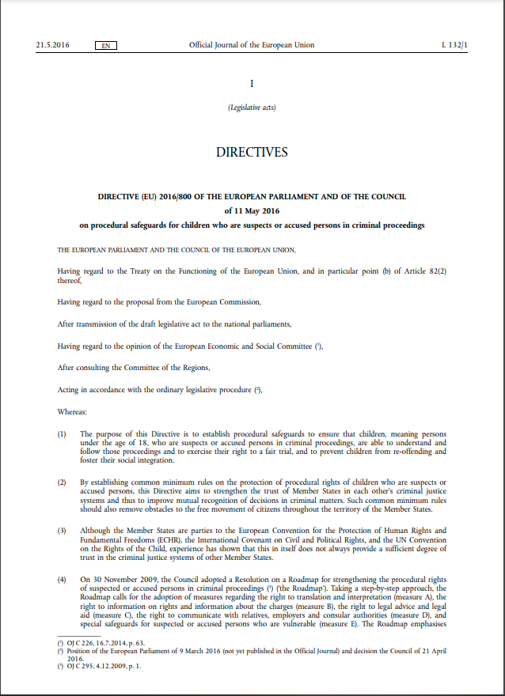
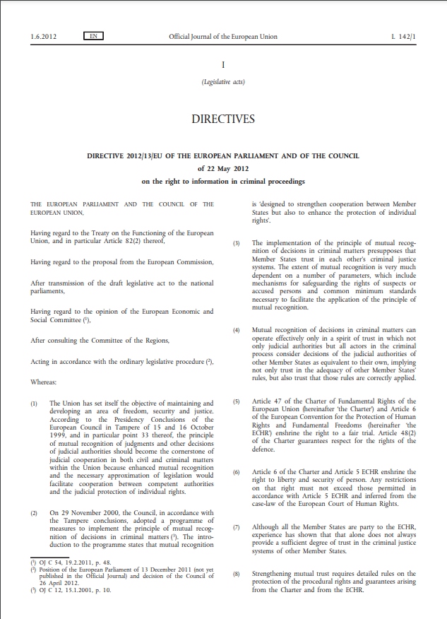
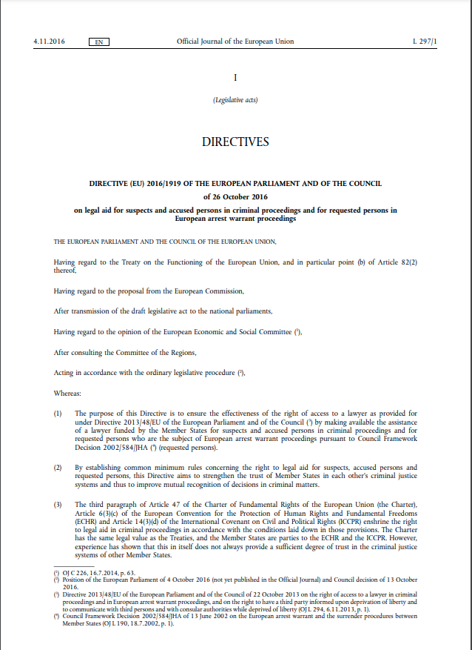
Part 1: Specific approach of the system
European standards
The project is co-funded by the Justice Program of the European Union (2014 – 2020)
Logo of your organisation
Notes:
Among European standards regarding child justice systems (for children accused, suspected or convicted for an offence), two type of sources are particularly interesting: the Council of Europe Guidelines on child friendly Justice and EU directives.

Slide 12

Part 1: Specific approach of the system
European standards
Participation
Council of Europe Guidelines on child friendly Justice
Rule of law
Dignity
Protection from discrimination
Best interests
The project is co-funded by the Justice Program of the European Union (2014 – 2020)
Logo of your organisation
Notes:
The Guidelines are available online: https://rm.coe.int/16804b2cf3
The Council of Europe Guidelines on child-friendly justice provide extensive guidance on what a child-friendly justice system should look like. They are not only relevant to children accused, suspected or convicted of an offence, as they apply to any justice (or administrative) procedure that involves children, such as procedures related to migration, family separation etc., irrespective of the child's status in it (perpetrator, victim, applicant etc.).
According to the Guidelines (and inspired by the ECtHR and many other international standards mentioned in the preambule of the Guidelines), the 5 following principles are fundamental for a child-friendly system:
Participation: children have the right to be informed about their rights, and they should be heard in proceedings ➔ “This includes giving due weight to the children’s views bearing in mind their maturity and any communication difficulties they may have in order to make this participation meaningful.”
Best interests of the child: the right of children to have their best interests be a primary consideration in all matters involving or affecting them.
- Dignity: it includes protection against torture and other inhuman or degrading treatments but also : “Children should be treated with care, sensitivity, fairness and respect throughout any procedure or case, with special attention
for their personal situation, well-being and specific needs, and with full respect for their physical and psychological integrity”.
Protection from discrimination: The rights of children shall be secured without discrimination on any grounds + Specific protection and assistance may need to be granted to more vulnerable children (such as Roma children, migrant children, children with disabilities, etc.)
Rule of law: The rule of law principle should apply fully to children as it does to adults + the elements of the due process should also apply to children.
These guidelines are also very interesting because they provide with very concrete measures to be taken so that the justice system is child-friendly, such as the list of information a child should receive at the beginning of the procedure, content of the training of professionals, or the timing of the procedures (including breaks, avoiding undue delays etc.).
More information on the child friendly justice Guidelines are available on Module 2, which is dedicated to child friendly justice.

Slide 13
Part 1: Specific approach of the system
European standards – EU Directives
Directive 2010/64/EU on the right to interpretation and translation in criminal proceedings,
Directive 2012/13/EU on the right to information in criminal proceedings,
Directive 2013/48/EU on the right of access to a lawyer in criminal proceedings,
Directive (EU) 2016/343 on the presumption of innocence and of the right to be present at the trial in criminal proceedings,
Directive (EU) 2016/1919 on legal aid for suspects and accused persons in criminal proceedings
Directive (EU) 2016/800 on procedural safeguards for children who are suspects or accused persons in criminal proceedings
The project is co-funded by the Justice Program of the European Union (2014 – 2020)
Logo of your organisation
Notes:
The European Union has devoted a wide range of procedural safeguards to persons suspected or accused in criminal proceedings by following the “Roadmap for strengthening their procedural rights”. The 5 following directives influence proceedings for children in conflict with the law, but the most interesting for us is the one dedicated to children : (EU) 2016/800.
To date, five EU directives address the rights of suspects and accused persons in criminal proceedings (both for children and adults).
Directive 2010/64/EU on the right to interpretation and translation in criminal proceedings, 2010 (for children and adults);
Directive 2012/13/EU on the right to information in criminal proceedings, 2012 (for children and adults);
Directive 2013/48/EU on the right of access to a lawyer in criminal proceedings, 2013 (for children and adults);
Directive (EU) 2016/343 on the presumption of innocence and of the right to be present at the trial in criminal proceedings, 2016 (for children and adults);
Directive (EU) 2016/1919 on legal aid for suspects and accused persons in criminal proceedings, 2016 (for children and adults).
In 2016, the EU adopted the directive (EU) 2016/800 on procedural safeguards for children who are suspects or accused persons in criminal proceedings, with the aim of setting minimum binding standards across EU Member States. This directive is the only one which is addressed specifically to children in conflict with the law and therefore it represents the main instrument by which certain principles of child-friendly justice have been incorporated into EU law.
Directive (EU) 2016/800, recital 1: “The purpose of this directive is to establish procedural safeguards to ensure that children, meaning persons under the age of 18, who are suspects or accused persons in criminal proceedings, are able to understand and follow those proceedings and to exercise their right to a fair trial, and to prevent children from re-offending and foster their social integration”.
It also contains specific dispositions on:
Art. 4 Right to information
Art. 5 Right of the child to have the holder of parental responsibility informed
Art. 6 Assistance by a lawyer
Art. 7 Right to an individual assessment
Art. 8 Right to a medical examination
Art. 9 Audiovisual recording of questioning
Art. 10 Limitation of deprivation of liberty
Art. 11 Alternative measures
Art. 12 Specific treatment in the case of deprivation of liberty
Art. 13 Timely and diligent treatment of cases
Art. 14 Right to protection of privacy
Art. 15 Right of the child to be accompanied by the holder of parental responsibility during the proceedings
Art.16 Right of children to appear in person at, and participate in, their trial
Art 18. Right to legal aid
Art 19. Remedies
Art. 20 Training
Etc.

Slide 14




Part 1: Specific approach of the system
National law
The project is co-funded by the Justice Program of the European Union (2014 – 2020)
Logo of your organisation
Notes:
Select the map of your country, place it in the upper right corner and delete the others.
Give information regarding the philosophy of the system in your country (the main law on child justice, the code of youth justice or even the preparatory documents of these laws can provide a good explanation of the philosophy and goals of the system of justice for children suspected or accused in your country).

Slide 15
Part 1: Specific approach of the system
Discussion: is our national system in line with these international standards ?
The project is co-funded by the Justice Program of the European Union (2014 – 2020)
Logo of your organisation
Notes:
Before starting part 2 of this module, ask your participants: is our national system in line with these international standards? (not pointing every rule that is not perfectly implemented or every part of the proceeding, but only the general philosophy of the system: does the system promote diversion? Does it respect the dignity of the child? Does it takes into account the child’s age and specific needs?
Replace the map of Belgium by the one of your country (available on slide 14)

Slide 16
Part 2
From the infraction to the release, description of the different stages of the proceeding at national level
The project is co-funded by the Justice Program of the European Union (2014 – 2020)
Logo of your organisation
Notes:
For lawyers who intend to represent a minor suspected or accused of an offence, or who do so on an ad hoc basis, they may need to know a little more about the specific procedure that applies to minors. For this purpose, we propose in this second part of the module to present this procedure, using a PowerPoint presentation of about 50 minutes.
We suggest that you include in this presentation:
A presentation of the relevant legal sources: article of the Constitution, laws, Code or any kind of regulation, and if relevant major jurisprudence);
A definition of the child and the minimum age of criminal responsibility;
A comprehensive description on the various phases of the proceeding (instruction, judgment, execution of the sentence/measure, appeal) and the institutions involved (is it a specialised police for children, is it a specialised prosecutor for children, youth judge, child protection services, etc.);
Emphasize the role of the lawyer according to national law and jurisprudence, at which steps should the lawyer be present?;
Presentation of the different measures/sentences that can be taken against a minor.

Slide 17
Part 3
Who is Who?
The project is co-funded by the Justice Program of the European Union (2014 – 2020)
Logo of your organisation
Notes:
The aim of this exercise, which focuses on actors and institutions, is to ensure that the participants integrate the information described in the previous PowerPoint presentation, but also that they are aware of all the actors and institutions that can intervene in the case of a minor, e.g. institutions for the protection of minors, psychologists, social workers, etc., and above all, it will be an opportunity for you to present the role and missions of each of them.

Slide 18
Part 3: Who is who?
Appeal
Investigation
Pre-trial
Trial
Execution of the sentence
List of actors and institutions: police, victim, prosecutor, judge, jury, court of appeal, lawyer, mediation service, youth protection service, etc.
The project is co-funded by the Justice Program of the European Union (2014 – 2020)
Logo of your organisation
Notes:
Create a diagram representing the different phases of the procedure (investigation, pre-trial, trial, execution of the sentence, appeal etc.) in frames or adapt the one on this slide.
Make a list of relevant professionals and institutions (police, victim, prosecutor, judge, jury, court of appeal, lawyer, mediation service, youth protection service, etc.): one of the challenges in understanding a procedure is to learn the names of each institution and their acronyms, so don't use generic names like "protection service" here, but use the precise names of the different institutions and/or acronyms.
Ask the participants, to seat in groups of 3 to 4 people and to place the institutions and professionals in each relevant stages. Give the participants 15-20 minutes and then open a plenary session and share additional information by letting each group present one step of the procedure and completing with information on the role of these actors.

Slide 19
Part 4
Procedural rights of the child suspect at the police station
Brainstorming
The project is co-funded by the Justice Program of the European Union (2014 – 2020)
Logo of your organisation
Notes:
Procedural rights of the child suspect at the police station – brainstorming 20’
It is fundamental for lawyers to ensure that their young clients’ rights are respected when they are in contact with the police. In addition, they have the duty to inform their young clients about their rights. Check with a quick brainstorm that the participants have all these rights in mind and that they know how to react if they are not respected. This quick brainstorm can be an opportunity for some participants to give evidence of practices they observe that are contrary to children's rights (one time or systemic violations of children’s rights). If it is the case, give the opportunity to other participants to suggest possible remedies/actions and if they don’t, suggest possible actions for the lawyer.
Start the brainstorm: ask your participants to answer the following question: What are the rights of child suspects when dealing with the police?
At the end of the brainstorming, make sure you cover the following questions:
Can the child call his/her parents or another person; right to silence; right to be aware of the charges against him/her; right to a lawyer (before and during the hearing); right to an interpreter; right to leave or not; maximum length of the detention; access to a doctor; reading and modification of the minute of the hearing; use of constraint.

Slide 20
Part 5
Procedural rights of the child during a hearing with a judge
Brainstorming
The project is co-funded by the Justice Program of the European Union (2014 – 2020)
Logo of your organisation
Notes:
Procedural rights of the child during a hearing with a judge – brainstorming 15’
Hearings with judges are another very important stage of the proceeding for children in conflict with the law. Take 10 to 15 minutes for a new brainstorming with the participants. If some participants mention practices they observe that are contrary to children's rights (one time or systemic violations of children’s rights), give the opportunity to other participants to suggest possible remedies/actions and if they don’t, suggest possible actions for the lawyer.
Start the brainstorm: ask your participants to answer the following question: What are the rights of children before and during a hearing with a judge?
Write on the blackboard or on another slide of the PowerPoint the answers of the participants.
At the end of the brainstorming, make sure you cover the following questions: presence of the lawyer, information by the lawyer before the hearing, information after the hearing by the lawyer, interpretation, timing, use of constraint, etc.

Slide 21
Part 6
Informing young persons on their rights and the procedure
Child friendly support and role play
The project is co-funded by the Justice Program of the European Union (2014 – 2020)
Logo of your organisation
Notes:
Lawyers for children have the very important role of properly informing children about their rights and the procedure. This last part of the module aims at providing participants with a child-friendly document they can use with their young client to explain the proceeding (the scheme entitled What can happen next?), to put them in the situation of informing children in a way that is adapted to the situation and their special needs (game card/role play) and to conclude with a list of advices regarding the information of the child.

Slide 22
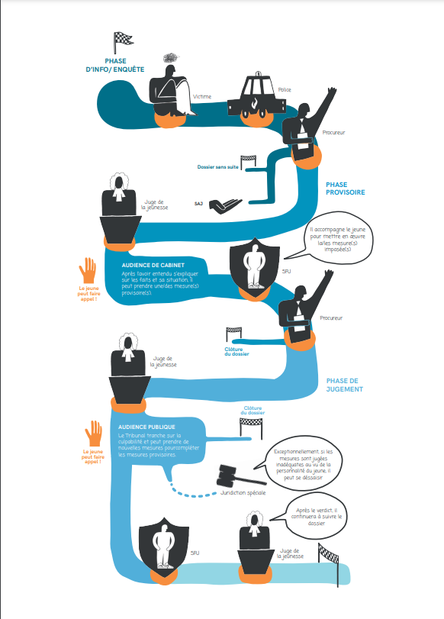
Part 6: Information
Using a child-friendly support to inform the child on the next steps of the procedure
The project is co-funded by the Justice Program of the European Union (2014 – 2020)
Logo of your organisation
Notes:
Presentation of the scheme - What can happen next?
Adapt the scheme of the procedure available page 14 and 15 of this Guide for minors: https://lachild.eu/wp-content/uploads/2021/11/Know-ur-rights-FinalBrochureEN.pdf to your national procedure and then to present it to the lawyer so that they can use it in the future with their young clients: send it to the participants in pdf format and give them a printed version during the training. You can find all information to adapt the scheme to your national context in this step-by-step manual https://lachild.eu/wp-content/uploads/2021/11/Step-by-step-Manual-How-to-adapt-it.pdf (you can even adapt the all Guide to your national context).
Replace the drawing of the Belgian proceeding on this slide by the adapted version for your country.
Give a printed version to the participants and start a short conversation on the using of child-friendly support documentation to help with the information of young client (ask participants to share with the other if they use child friendly material)

Slide 23






Part 6: Information
Informing a child – Role play
Pair up;
Pick situation 1;
Read the situation;
Play the situation: really embody the child or the lawyer you are supposed to be;
Take notes on the card,
Finish the play and exchange with your pair about your impressions and what you wrote.
Do it again with situation 2, 3 and 4
The project is co-funded by the Justice Program of the European Union (2014 – 2020)
Logo of your organisation
Notes:
This role play aims at being the opportunity for lawyers to practice on the way they give information to young clients on their rights and procedures. Each lawyer will have to endorse the role of a lawyer and the role of a child.
Before the training: adapt the cards available on the PowerPoint in national languages and/or to national context if needed. Print them.
Steps of the role play:
Ask participants to pair-up;
Give to each pair the 8 cards available in the PowerPoint, more precisely to each participants A the “A-cards” and to each participants B the “B-cards”;
Pairs have about 20 minutes to play the 4 situations. Inform the participants that they do not receive the same information if they are a lawyer or a child. Participants playing lawyers have the mission to properly inform the child about their rights and the procedure. They have 4-5 minutes per situation, they should: read the situation, play the situation (emphasize that it is very important for them to step into the shoes of their character – they shouldn’t talk using the third person but really embody the character), take notes on their cards, finish the play and exchange with their pair about their impressions and what they wrote.
Give 5 minutes to the all group to sit again in their places and to reflex on the main challenges they faced during the role play.

Slide 24

Situation 1 – The minor
A
B
Situation 1 – The lawyer
Situation: You are a 17 year old boy. You have just been arrested by the police with some cannabis on you. The police also found 5 cell phones in your pockets. You don’t want to talk to the police nor to anyone else. You are sure that you will be out in one or two hours if you remain silent and do not tell a word to anyone.
A professional enters the room, s/he start talking to you.
Situation: You are a lawyer, you have been called to represent a 17 years old boy who have just been arrested by the police with an important quantity of cannabis and 5 cell phone on him. The police wants to interrogate him, you have only 5 minutes with him before the hearing with the police.
You enter the room and start talking with your young client.
What did you understand?
What did you understand from the child? What did you tell him?
Notes:
Translate and/or adapt the following cards. Give to each group the 8 cards, each one should have two cards “minor” and two “lawyer”.

Slide 25
Situation 2 – The minor
B
A
Situation 2 – The lawyer
Situation: You are a 14 years old boy and you have just been arrested by the police for vandalism (with a friend, you made a graffiti on a building and the police caught you in the act). You are very scared about what will happen, what the police is going to do with you, what will be the reaction of your parents when they will know, what will be the consequences on your application to a new school, etc. You did not have time to speak with your friend and you think you should take all the blame for you two because it was your idea, he did not wanted to do this.
A professional enters the room, s/he start talking to you.
Situation: you are a lawyer, you have been called to represent a 14 years old boy who have just been arrested with another one for the vandalism of a building owned by the police. You have 5 minutes alone with him in the interrogation room to talk with him before the hearing with the police.
What did you understand from the child? What did you tell him?
What did you understand?
Notes:
Translate and/or adapt the following cards. Give to each group the 8 cards, each one should have two cards “minor” and two “lawyer”.

Slide 26
Situation 3 – The minor
A
B
Situation 3 – The lawyer
Situation: You are a 15 years old girl, you will be heard by the police next week as a suspect regarding the harassment and violence against a girl of your school. You have developmental disorder, you speak and act as would a younger girl (8 – 10 years old). You do not understand the situations and explanation as most of 15 y-o teenagers would.
Your parents drove you to the office of your lawyer ahead of the hearing next week with the police. They stay in the meeting room while you enter in the desk of the lawyer.
Situation: You are a lawyer, three days ago you received a call from parents of a 15 years old girl who is about to be heard by the police because they suspect she harassed and was physically violent against another girl of her school. You arranged a meeting in your office in order to prepare the hearing with your new young client. The hearing with the police will be next week.
You enter in the waiting room and invite the girl (Sofia) to come to your office, your ask the parents to wait in the waiting room.
What did you understand from the child? What did you tell her?
What did you understand?
Notes:
Translate and/or adapt the following cards. Give to each group the 8 cards, each one should have two cards “minor” and two “lawyer”.

Slide 27
Situation 4 – The minor
B
A
Situation 4 – The lawyer
Situation: You are a 16 years-old boy who has been arrested a few weeks ago for very serious acts of violence against another young person. You have been placed in pre-trial detention and you will see again a youth judge for a chamber hearing this afternoon.
Your are deaf, you usually communicate with sign languages, you manage to read a bit on lips, you can talk.
While you sit on the waiting room in the Courthouse, a professional comes to talk with you.
Situation: You are a lawyer. You have been called by the legal aid office few days ago to represent a 16 years old boy who is currently placed in pre-trial detention for very serious acts of violence against another young person. He will meet a youth judge today, for a chamber hearing during which the judge will assess the necessity of maintaining the child in pre-trial detention.
You arrived 20 minutes before the hearing at the courthouse in order to meet your young client. You see him in the waiting room and offer him to follow you in the office which is available for lawyers next to the judge’s chamber.
What did you understand?
What did you understand from the child? What did you tell him?
Notes:
Translate and/or adapt the following cards. Give to each group the 8 cards, each one should have two cards “minor” and two “lawyer”.

Slide 28

Part 6: Information
Summary on information on rights and procedure
Charges
Role of the lawyer;
Protective logic of the system (if it is);
Procedure: actors and possible outcomes;
Appeal;
Rights.
in a manner adapted to each child (age, vulnerabilities, understanding, experience and knowledge of justice, emotional state)
clear, situation appropriate and complete information
child-friendly material
Balance ➔ do not overwhelm the child
The project is co-funded by the Justice Program of the European Union (2014 – 2020)
Logo of your organisation
Notes:
Based on pages 41 to 43 of the GUIDELINES FOR CHILD-FRIENDLY LEGAL AID FOR CHILDREN IN CONFLICT WITH THE LAW - Recommendations and inspiring practices aimed at legal aid providers and policy makers (https://lachild.eu/wp-content/uploads/2021/10/LA-CHILD_EN_LowRes.pdf ), summarize all key information about how to inform a child:
Regarding information on rights and procedure, the lawyer should “give the most detailed and appropriate information to the situation and to the child” (LA Child report), the lawyer should:
• Give the information in a manner adapted to each child: taking into consideration his/her age, vulnerability, capacity of understanding, experience and knowledge of justice and emotional state;
• Taking this into account, the lawyer should give the most clear, situation appropriate and complete information possible;
• Using child-friendly material can be useful;
• Take care not to overwhelm the child with too much information. It is a question of balance between the obligation to give information and the needs of the child, which the lawyer will have to analyse for each individual case.
Among the important information that the child should receive, the lawyer should explain:
the charges against him/her;
the role of the lawyer;
the protective logic of the justice system for children;
how the procedure will take place, the role of different actors and the possible outcomes;
the possibilities for appeal;
the specific rights of the child at each and every stage of the proceedings (e.g. the right to be silent, to ask for an interruption of the hearing in order to talk to his/her lawyer, to not answer certain questions, and so on.)

Slide 29
Part 6: Information
“Sometimes you get a bit caught up in the thing and you
focus on the facts, and the few times I didn’t explain the
rights properly (the right to silence, for example), I regretted it. You really have to insist on this because sometimes, during a police interview, they don’t remember, and they will invent anything to be able to respond.”
Child lawyer in Belgium
The project is co-funded by the Justice Program of the European Union (2014 – 2020)
Logo of your organisation
Notes:
To finish the module, you can share this inspiring testimony from a lawyer in Belgium.

Slide 30
Thank you for your participation !
The project is co-funded by the Justice Program of the European Union (2014 – 2020)
Logo of your organisation

